Slide 1

South Morningside Primary
Welcome
Our Journey to Excellence
Information Evening for Parents
17 September 2013

Slide 2
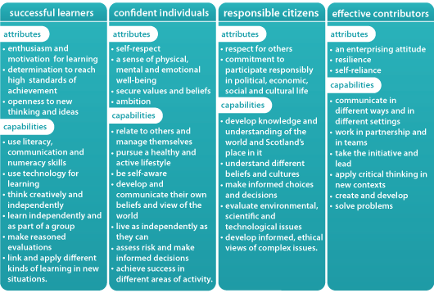
THE PURPOSE OF OUR CURRICULUM FOR EXCELLENCE

Slide 3
Building our Curriculum for Excellence
PRINCIPLES for CURRICULUM DESIGN
CHALLENGE & ENJOYMENT
BREADTH
PROGRESSION
DEPTH
PERSONALISATION & CHOICE
COHERENCE
RELEVANCE

Slide 4
Our Curriculum for Excellence
THE 4 CONTEXTS for LEARNING
ETHOS and LIFE of the SCHOOL
INTERDISCIPLINARY LEARNING
CURRICULUM AREAS and DISCRETE SUBJECT LEARNING
OPPORTUNITIES for PERSONAL ACHIEVEMENT

Slide 5
Entitlement to learn Skills for Learning, Life and Work.
“Every child and young person is entitled to develop skills for learning, skills for life and skills for work, with a continuous focus on literacy and numeracy and health and wellbeing.”
(Building the Curriculum 3: A framework for learning and teaching, p15)

Slide 6
Shoulder Partner Task
What do you consider to be the most important aspect of learning to prepare your child for life in the 21st Century?

Slide 7
SMPS Our Journey to Excellence – a few examples.
SUCCESSFUL LEARNERS:
Motivation & enthusiasm for learning- Storyline approach and new topics.
Openness to new ideas and thinking- Cooperative Learning, Science & Technologies and their impact on society. Pupil Groups and impact on school improvement.
Learn independently and as part of a group- Cooperative Group challenges and variety of roles.
Link and Apply different kinds of learning to new situations- Making a Difference, Social Enterprise Projects.
CONFIDENT INDIVIDUALS:
A sense of physical, mental and emotional wellbeing- Growing Confidence Programme, Building Resilience.
Pursue a healthy and active lifestyle- 2 hours PE target reached!
Secure Values and Beliefs- School Values, RME opportunities to develop and express values and beliefs.
RESPONSIBLE CITIZENS
Develop knowledge and understanding of the world and Scotland’s place in it- Scots Focus, History/ Language/ Arts.
Understand different beliefs and cultures- RME, Social Studies programme. Commonwealth Games focus!
Evaluate Scientific and Technological issues- Science / Technology focus weeks and ECO Schools work.
EFFECTIVE CONTRIBUTORS
Develop an enterprising attitude- Making a Difference and charity support work.
Develop Resilience and self reliance- Growing Confidence, Residential experiences.
Communicate in different ways in different settings- Sharing Learning events. Expressive Arts and ICT.*
Apply critical thinking in new contexts. Solve problems.- HOTS tasks and challenges

Slide 8
Skills for Learning, Life and Work
Cooperative Learning approaches across whole school – learning to work in a team, everyone’s “voice on the table.”
Making a Difference project – enterprise, decision making, negotiation and presentation.
Presenting, sharing and explain learning ; e.g Scots Focus events
Higher Order Thinking Skills , (HOTS) approach across whole school. Teachers asked to identify HOTS challenges in lesson planning.
World of Work Day for all P7s at Boroughmuir High.
Pupil Voice- developing roles and responsibilities.
Wider achievement- teachers aware, supporting and encouraging.
HWB – All children receiving 2 hours of PE
HWB - Building RESILIENCE

Slide 9
BUILDING OUR CURRICULUM & PUPILS JOURNEY
Embedding our Values and building our school community.
Improving attainment and achievement for all children.
Implementing all 8 curriculum areas.
Creating revised programmes of study.
Designing experiences with key CfE principles in mind, e.g. relevance.
Planning learning across the 4 contexts for learning.
Challenge and Higher Order Thinking Skills.
Needs led targeted support.
Learning about Scotland’s history, culture and language.
Developing Outdoor Learning.

Slide 10
The eight curriculum areas are:
Expressive arts
Health and wellbeing
Languages
Mathematics
Religious and moral education
Sciences
Social studies
Technologies

Slide 11
Curriculum areas in more detail :
EXPRESSIVE ARTS
Participation in Performances and Presentations.
Art & Design ( 2D & 3D media and technologies)
Dance
Drama
Music
TECHNOLOGIES
Technological developments in society
ICT to enhance learning,
Business contexts
Computing Science contexts
Food and Textile contexts
Craft, Design, Engineering and Graphics contexts.
RME
CHRISTIANITY
Beliefs
Values and Issues
Practices and Traditions
WORLD RELIGIONS (* selected for study)
Beliefs
Values and Issues
Practices and Traditions
DEVELOPMENT of BELIEFS and VALUES
Developing tolerance and understanding, fairness, caring , sharing, honesty, respect, compassion and equality.

Slide 12
Reporting on your child’s progress.
Oct: Parent and teacher meetings .
Shared targets in core areas of maths/ language / health and well being.
Jan: Sharing of evidence of progress in learning and reaching targets.
* Note- This will replace an interim report.
April: Parent and teacher meetings
Shared targets in core areas of maths/ language / health and well being.
June: End of year report of progress in all 8 curricular areas, including CfE levels.

Slide 13
The Curricular Framework is arranged over 6 levels
Level | Stage
Early | The pre-school years and P1, or later for some.
First | To the end of P4, but earlier or later for some.
Second | To the end of P7, but earlier or later for some.
Third and Fourth | S1 to S3, but earlier for some. The fourth level broadly equates to Scottish Credit and Qualifications Framework level 4. The fourth level experiences and outcomes are intended to provide possibilities for choice and young people's programmes will not include all of the fourth level outcomes.
Senior phase | S4 to S6, and college or other means of study.

Slide 14
Evidence of progress in learning
SAY WRITE MAKE DO
APPLICATION of Knowledge and Skills
Setting a Challenge
Higher Order thinking tasks
Peer and self assessment
A programme of Standardised Assessment for Reading, Spelling & Maths.
Whole school/ cluster focussed assessment of writing
Moderation of standards across year groups/ levels and cluster
Tracking progress
Identification of needs and targeted support

Slide 15
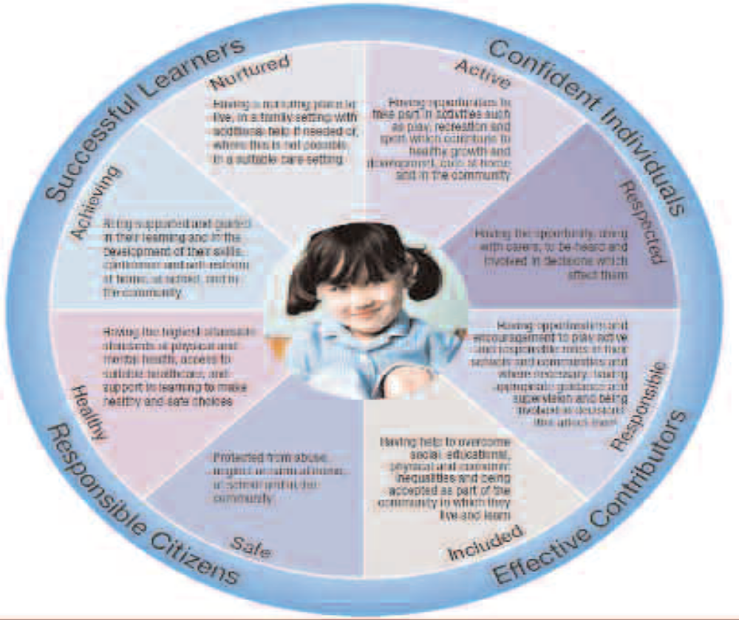
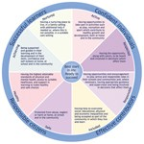
Wellbeing wheel

Slide 16
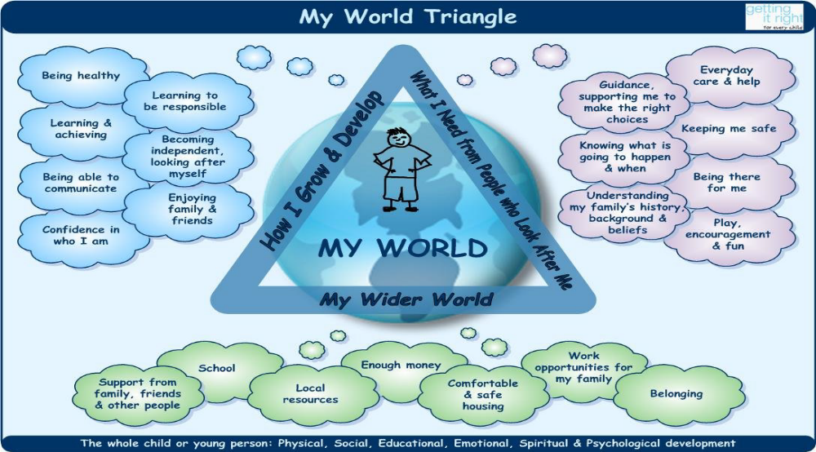
Getting it right for every child

Slide 17
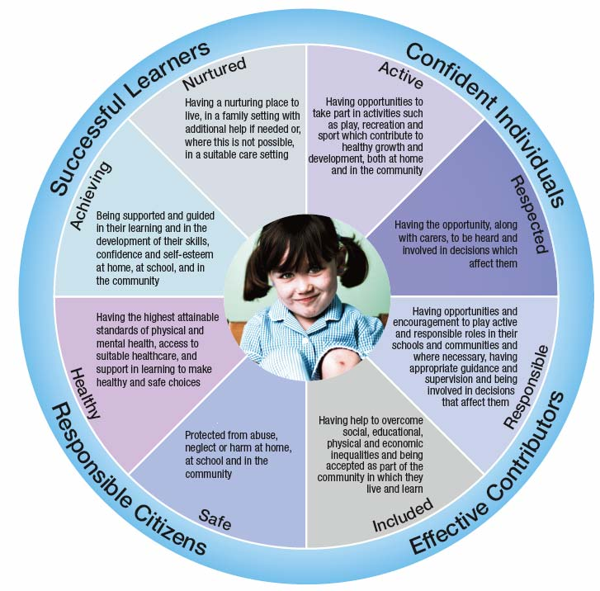
Improvement priorities and progress 2012-13
Priorities for improvement 2012-13
Continue to raise standards and improve attainment.
Science – implementation of and reporting on progress in Curriculum for Excellence outcomes and experiences.
Promotion of Outdoor Learning- planning outdoor learning experiences in Science across our whole school.
Modern Languages-implementation of and reporting on progress in Curriculum for Excellence outcomes and experiences.
Promoting Positive Mental Health & Emotional Wellbeing.
ICT Refresh- to replace our existing hardware and to install wireless connection.
ECO – To attain an ECO SCHOOLS Green Flag.
What progress have we made?
Standards of attainment in reading, writing and maths are very good. Almost all children have made significant improvement in their learning. There has been a further improvement in attainment by almost all children from last year.
Science-A revised programme for Science is in place from nursery to P7. We enjoyed a very successful whole school Science focus week when children learned about famous scientists and the impact of Science on society. We have created a Science Gallery. Children report enjoying science much more! Attainment in Science is very good.
Outdoor Learning- All teachers planned outdoor learning experiences in Science for the summer term. These took the form of a challenge, allowing children to apply their previous learning to a real life context.
Modern Languages- A programme of study has been agreed for P6 and P7 classes. Teachers across the Boroughmuir cluster have met to moderate standards.
Promoting Mental Health & Emotional Wellbeing- Teaching and support staff participated in 8 hours ‘Creating Confident Children” training. A three year implementation programme was agreed following this. Parent workshops were held for P2 and nursery parents.
ICT Refresh- We were ‘refreshed’ during the last week of term!
ECO Green Flag- The P6 year group have created a fantastic recycled plastic bottle greenhouse. We still have some work to do before we can apply for our green flag, but we’re getting close!

Slide 18
Priorities for Improvement 2013-14
Expressive Arts- Music, Art, Dance & Drama.
Implement Curriculum for Excellence experiences and outcomes and report on progress.
MADD WEEK.
Plan a whole school Music, Art, Dance and Drama Week when children will draw upon the skills learned over the course of the year to create, present , perform and evaluate. More details to follow!
Religious and Moral Education (RME)
Revise our RME programme.
Implement Curriculum for Excellence experiences and outcomes and report on progress.
Technologies
Implement Curriculum for Excellence experiences and outcomes and report on progress.
Focus on Technologies and its’ impact on society during our Science Week.
ICT –To increase access to laptops and I pads throughout our school. To create and implement a progressive skills programme. To teach aspects of online safety education at key stages, and safe and respectful use to all.
Introduce an ICT Code of Conduct agreement.

Slide 19
Improving Emotional Health & Wellbeing
Growing Confidence Programme
CONFIDENT STAFF, CONFIDENT CHILDREN TRAINING
Understanding brain development
Promoting attachment
Building Resilience
Developing Empathy
Exploring beliefs and Mind sets
Looking after your own well-being.
* RAISING CHILDREN WITH CONFIDENCE – workshops for parents*

Slide 20
Poster Parade Task-
Please comment on our Pupil Journeys + - ?
Please see the SIGNIFICANT ASPECTS of LEARNING posters for all curriculum areas.
You may want to consider the Principles of Curriculum Design:
CHALLENGE & ENJOYMENT
BREADTH
PROGRESSION
DEPTH
PERSONALISATION & CHOICE
COHERENCE
RELEVANCE

