Slide 1

South Morningside Primary
Growth Mindset

Slide 2


There are 2 kinds of ‘Mindset’………

Slide 3
P6C
Drama
Scenario 1
Scenario 2
Scenario 3

Slide 4
Fixed Mindset
I’m either good at it, or I am not
When I get stuck, I give up
I don’t like to be challenged
When I fail, I think that I’m no good

Slide 5
i
Growth Mindset
I can learn anything I want to
When I get stuck, I keep going
I want to challenge myself
When I fail, I learn

Slide 6
Growth Mind-set Video clip

Slide 7
How do I develop a growth mind-set?

Slide 8

Keep trying, even when something is hard
See mistakes as a chance to learn
Be eager for new challenges
I can’t do it……yet!

Slide 9




The Learning Pit
Good learners go into the PIT!!

Slide 10
Having a Growth mind-set
“Think about your hero. Do you think of this person as someone with extraordinary abilities who achieved with little effort? Now go find out the truth. Find out the tremendous effort that went into their accomplishment—and admire them more.”

Slide 11
So what have we learnt?
2 kinds of mind-set- Fixed Mind-set and growth Mind-set
A Growth mind-set helps you to grow your brain
I can’t do it….yet

Slide 12
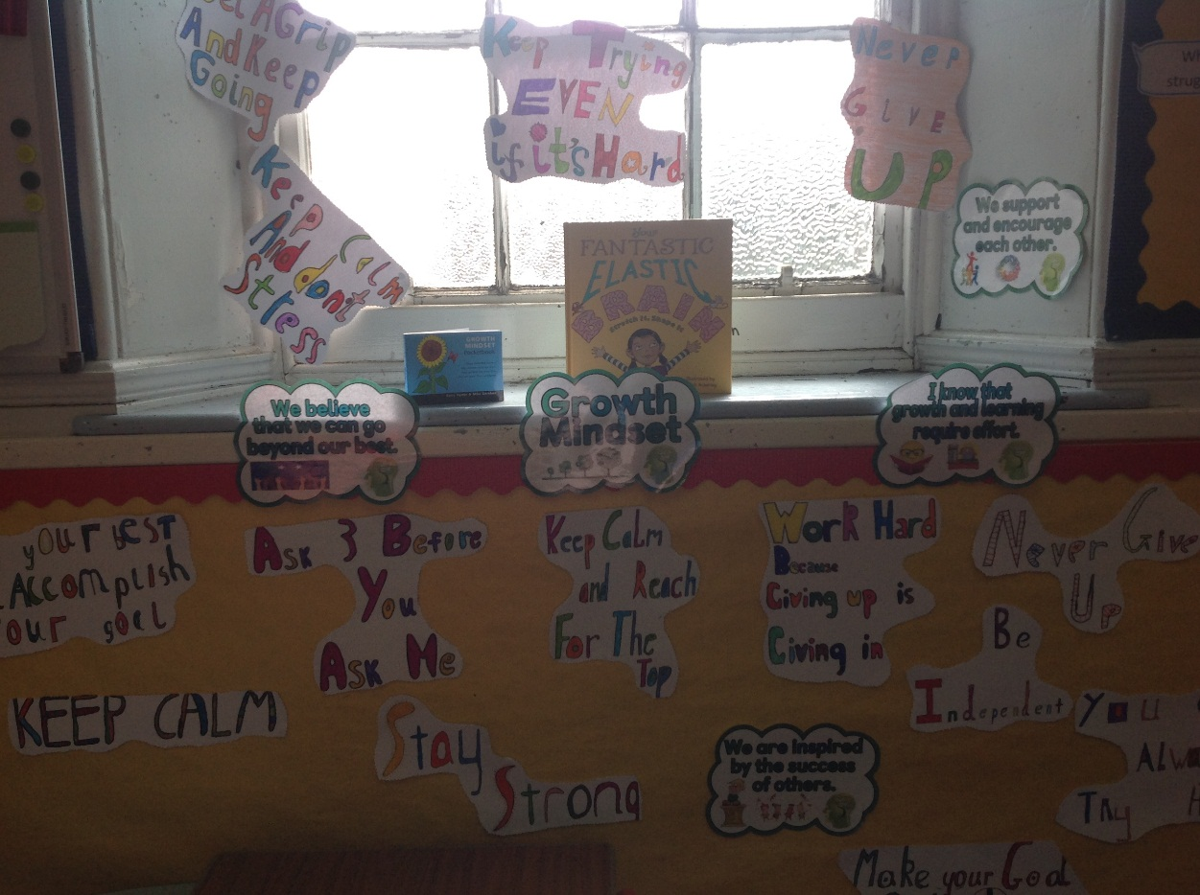
Class Task: Encouraging Wall

Slide 13
One thing to remember…..
I can’t do it …….yet!

Slide 14
Feed your brain!

Slide 15


