Slide 1


Slide 2

New Year Resolutions!

Slide 3

Mindset

Slide 4


There are 2 kinds of ‘Mindset’………

Slide 5
What can
YOU remember about a Fixed Mindset?

Slide 6
Fixed Mindset
I’m can either do it or I can’t do it
When I get stuck, I give up
I don’t like the challenge of new work
When I fail, I think that I’m no good

Slide 7
What can
YOU remember about a Growth Mindset?

Slide 8
i
Growth Mindset
I can learn anything I want to
When I get stuck, I keep going
I like the challenge of new work
I can’t do it …yet

Slide 9




The Learning Pit
Good learners go into the PIT!!

Slide 10
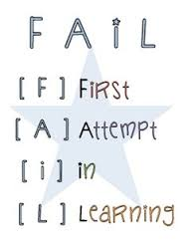
REMEMBER….....

Slide 11

Remember…...

Slide 12
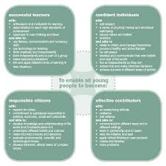
What else can help
us become successful
learners?

Slide 13

Effort leads to success!

Slide 14
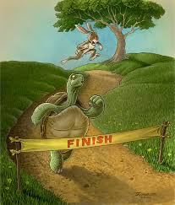
The Hare and The Tortoise
Effort
Hard Work
Confidence
Persistence

Slide 15
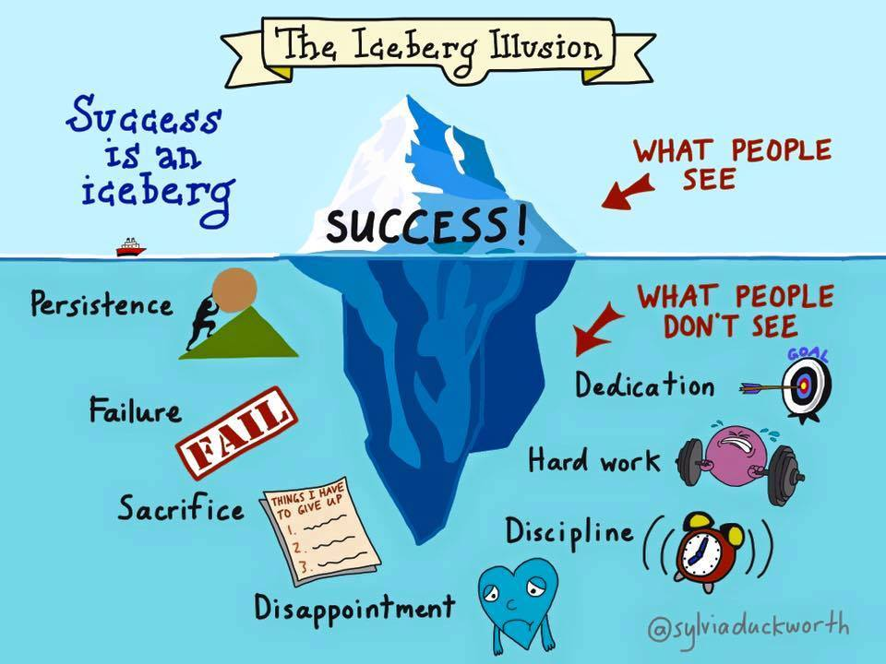

Slide 16
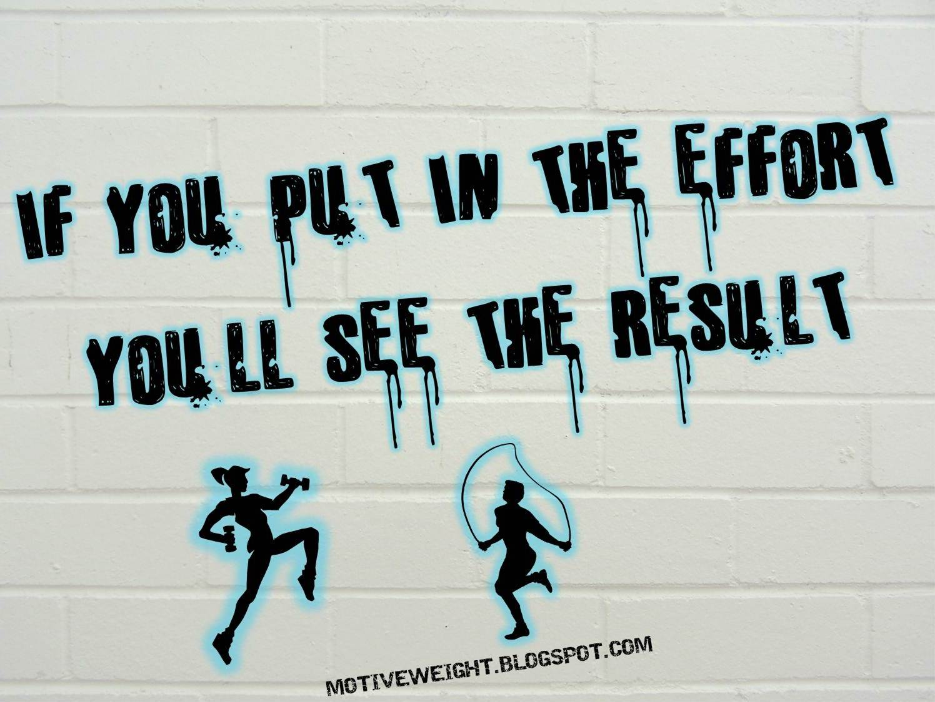
Term 3
Think about the effort you are putting in to your work.

Slide 17
Danny MacAskill
Danny Practising https://youtu.be/6F05UvSaIqs
Danny Film https://youtu.be/Z19zFlPah-o

Slide 18

Playground
Scots Focus
Winning House – Hermitage
Have a lovely weekend!

Slide 19
The Climb
https://youtu.be/uWj43alu1zg

