Slide 1

South Morningside Primary
Growth Mindset

Slide 2
What can YOU remember?

Slide 3


There are 2 kinds of ‘Mindset’………

Slide 4
What can YOU remember about a Fixed Mindset?

Slide 5
Fixed Mindset
I can either do it or I can’t do it.
When I get stuck, I give up.
I don’t like the challenge of new work
When I fail, I think that I’m no good

Slide 6
What can YOU remember about a Growth Mindset?

Slide 7
i
Growth Mindset
I can learn anything I want to.
When I get stuck, I keep going.
I like the challenge of new work
I can’t do it …yet

Slide 8
How do I develop a growth mind-set?

Slide 9
If you keep trying when you find something hard then you will grow a smarter brain!

Slide 10
One thing to remember…..
I can’t do it …….yet!

Slide 11


Slide 12
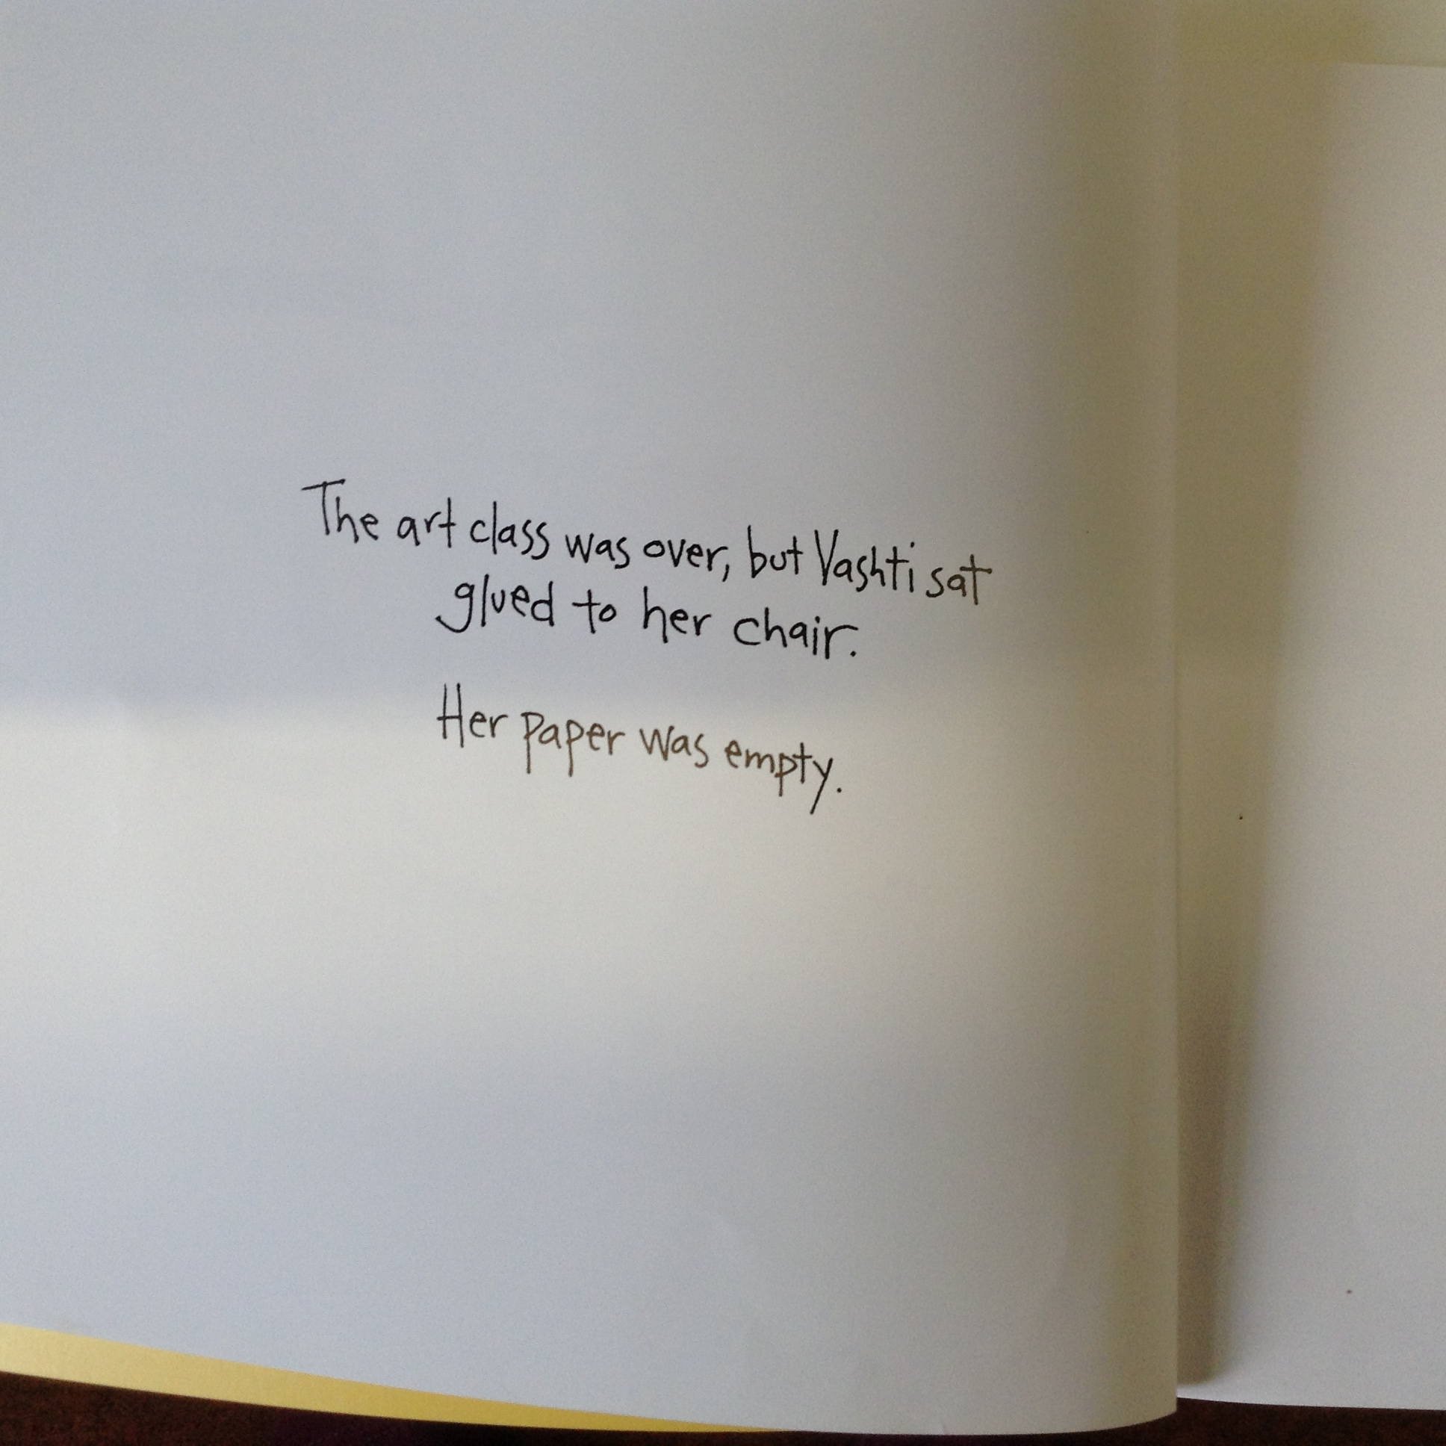

Slide 13
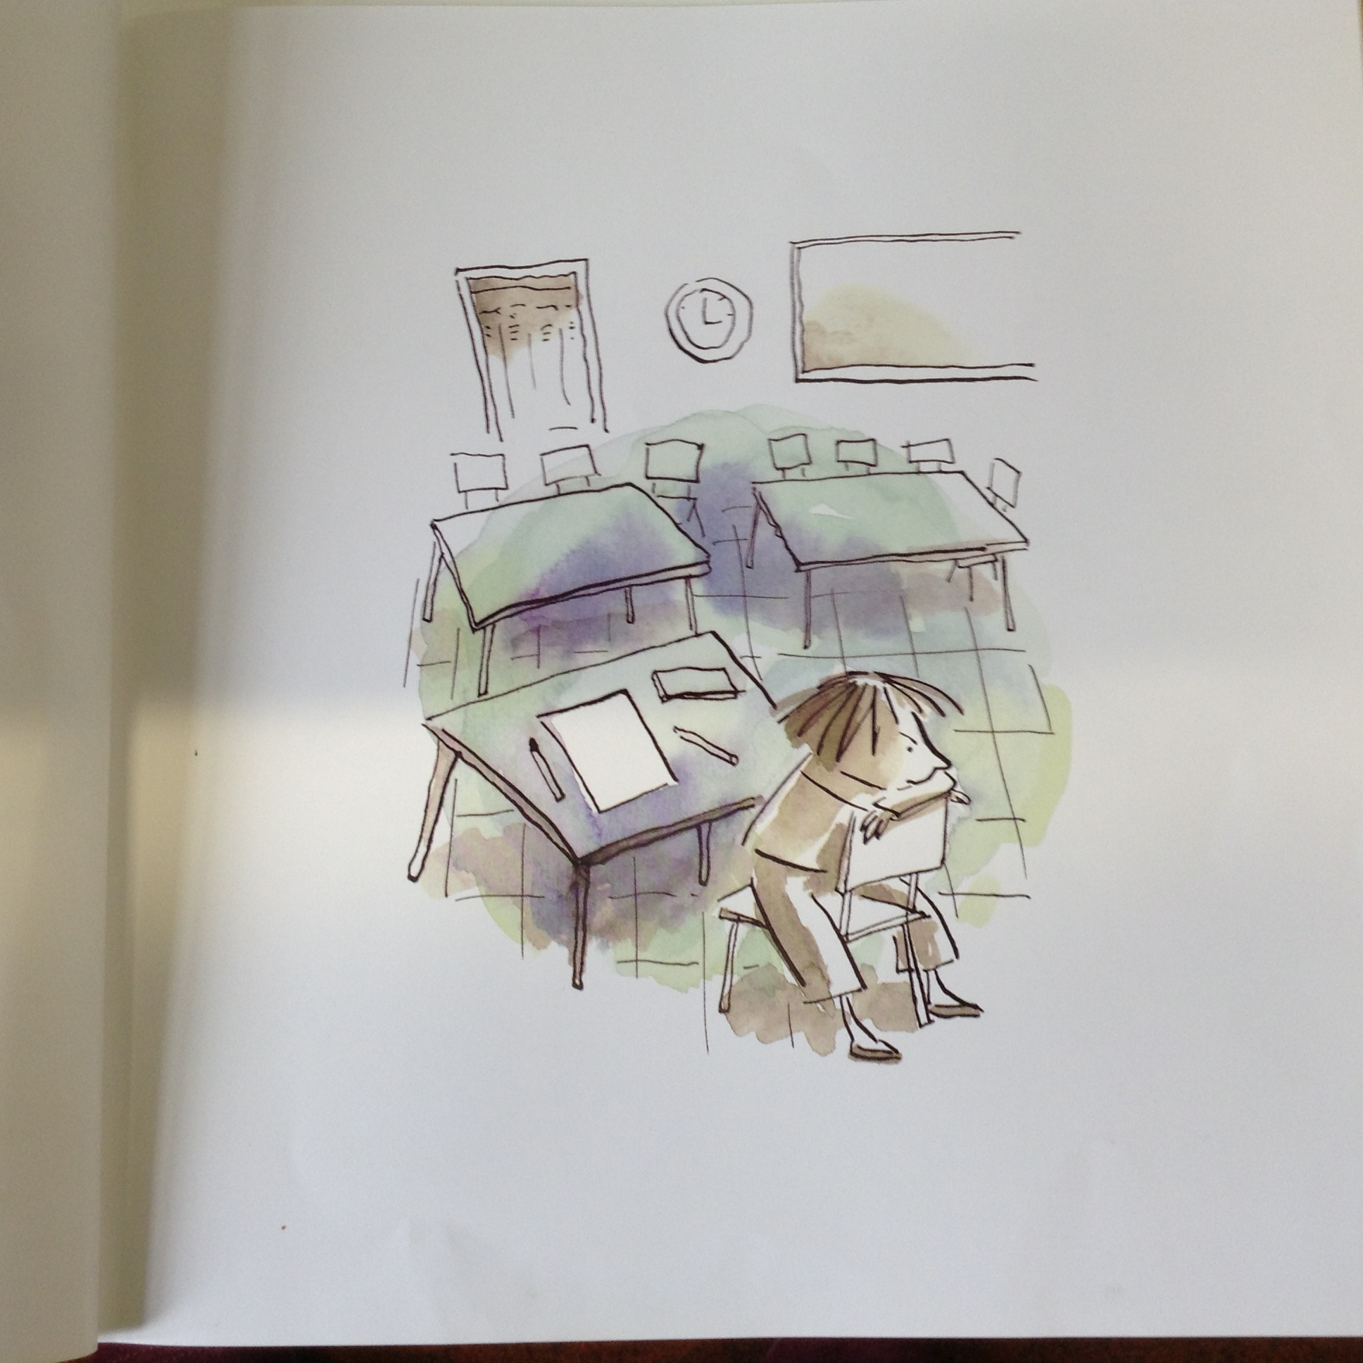

Slide 14
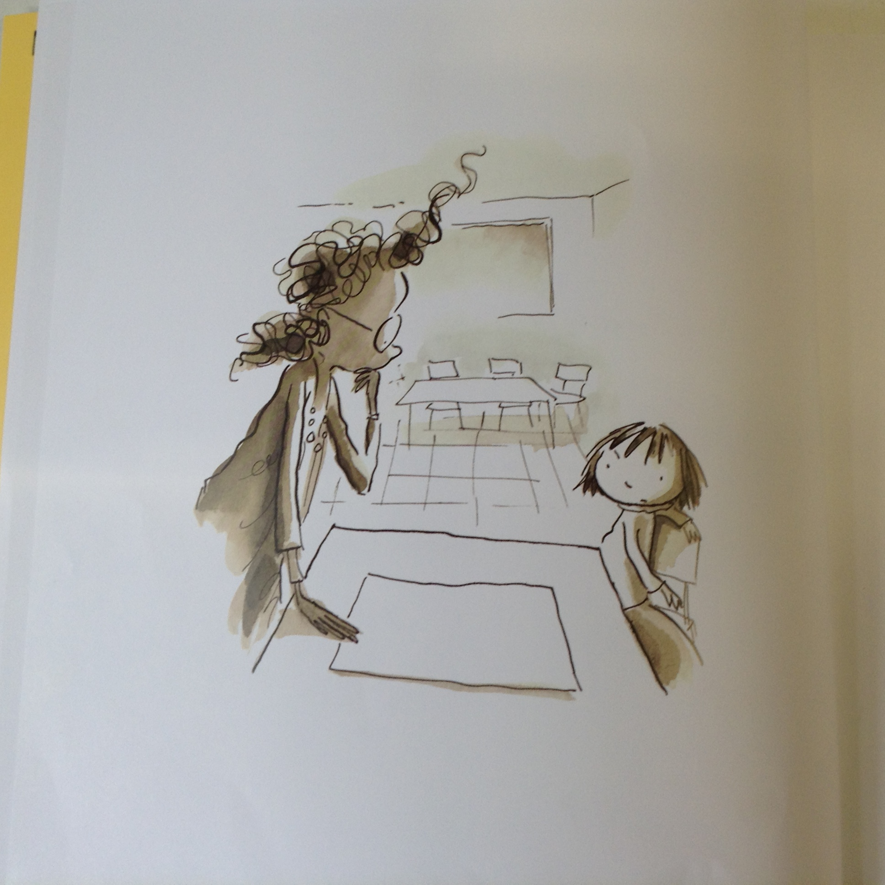

Slide 15


Slide 16
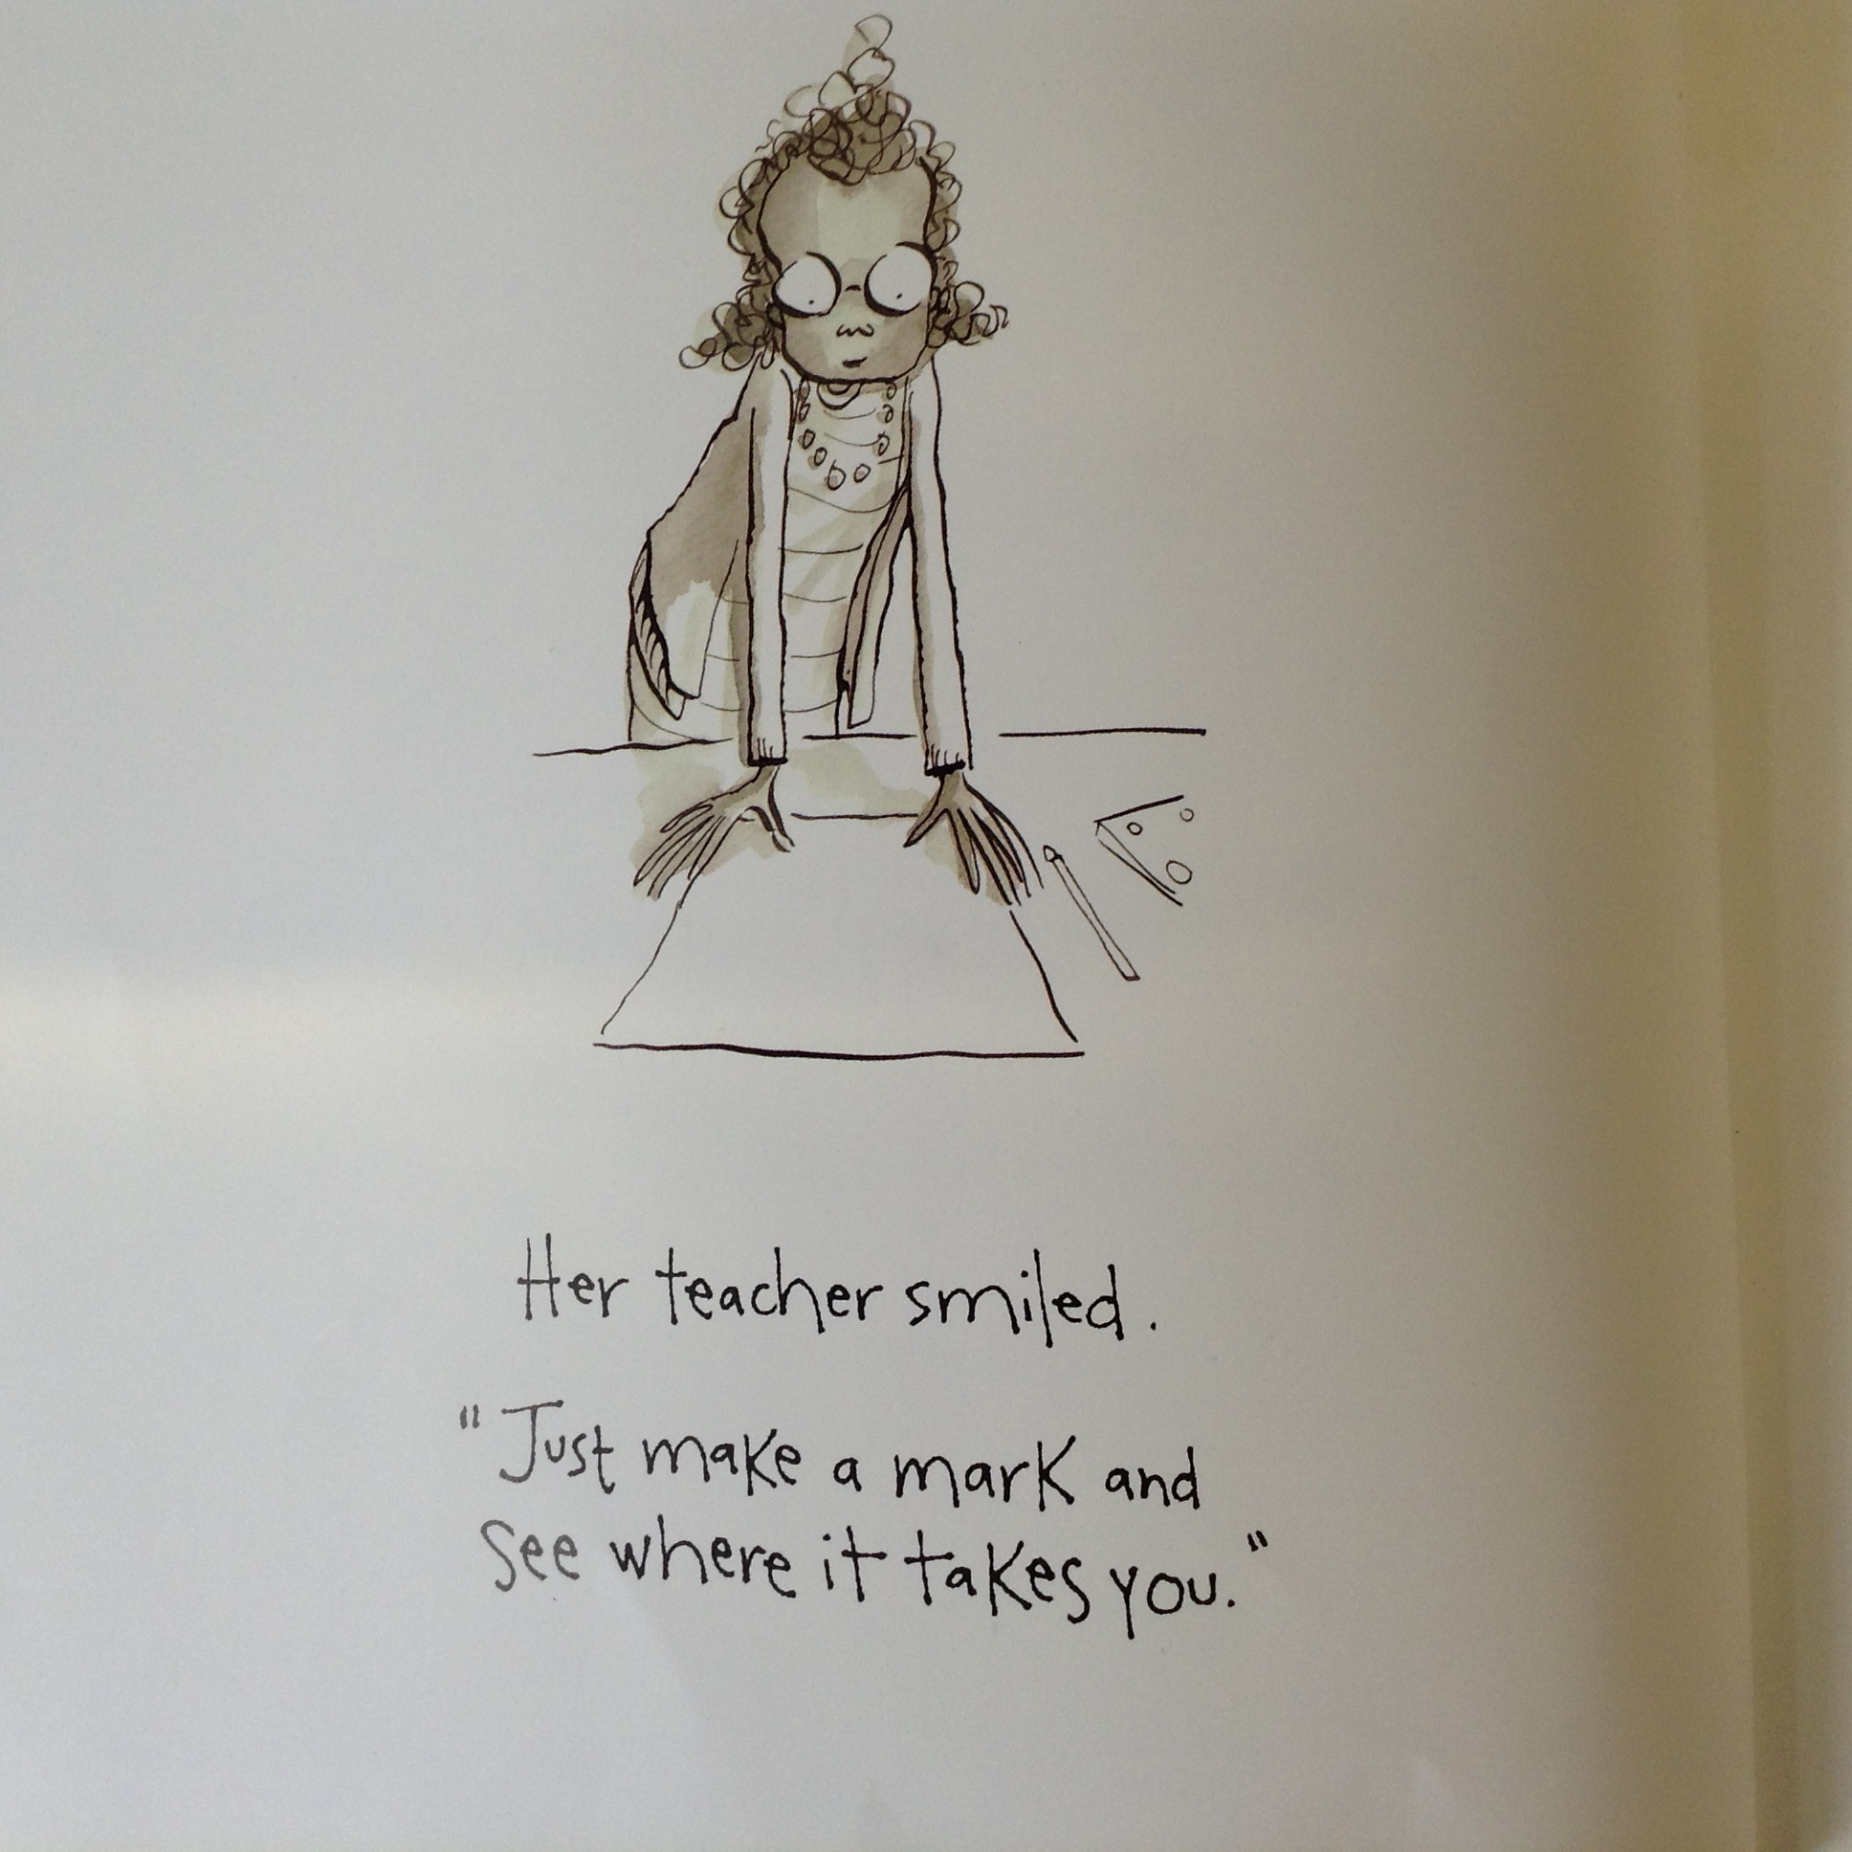

Slide 17


Slide 18
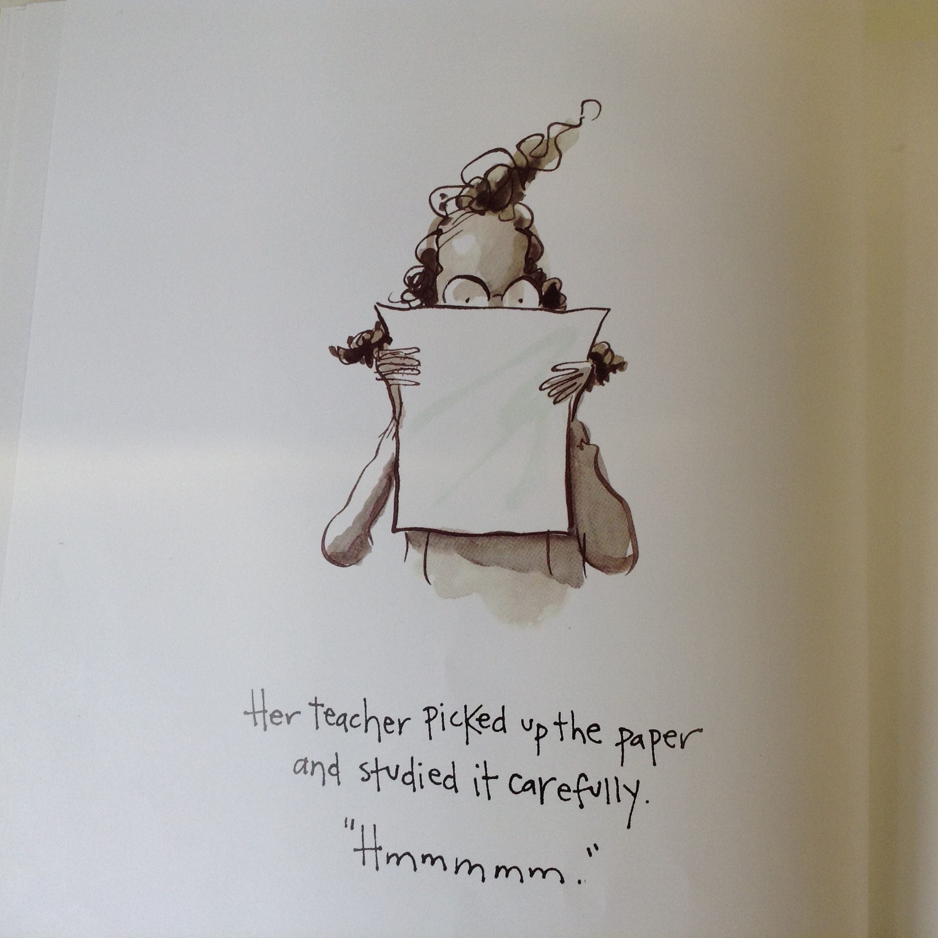

Slide 19
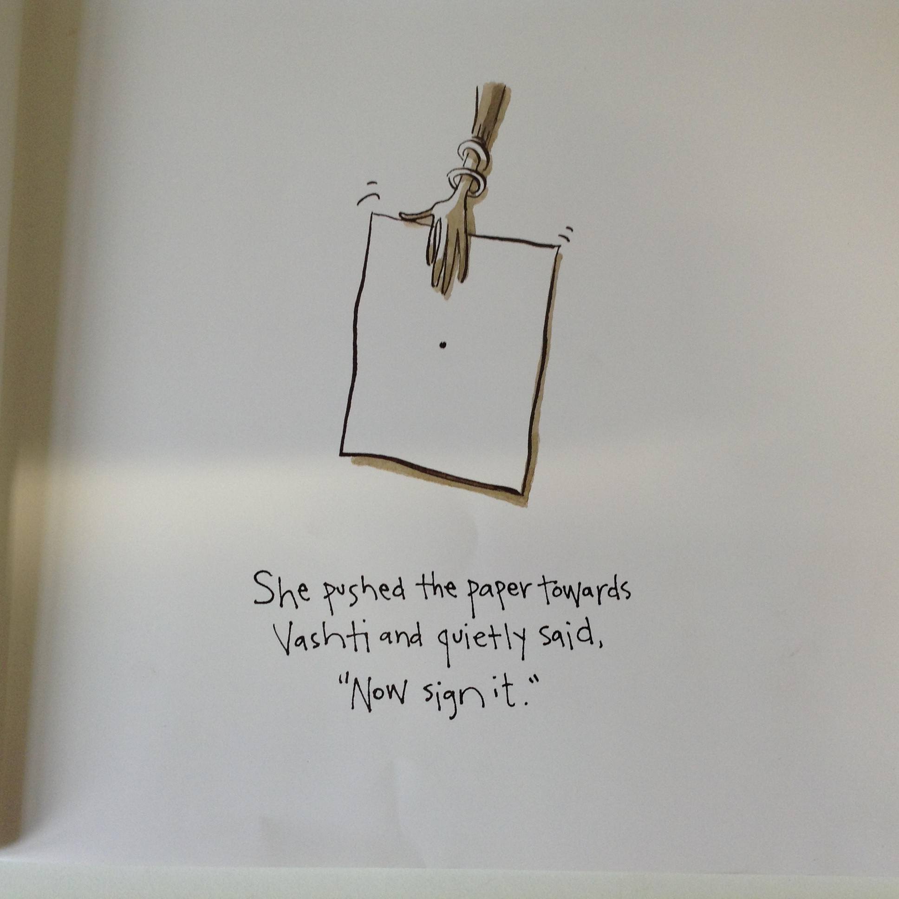

Slide 20
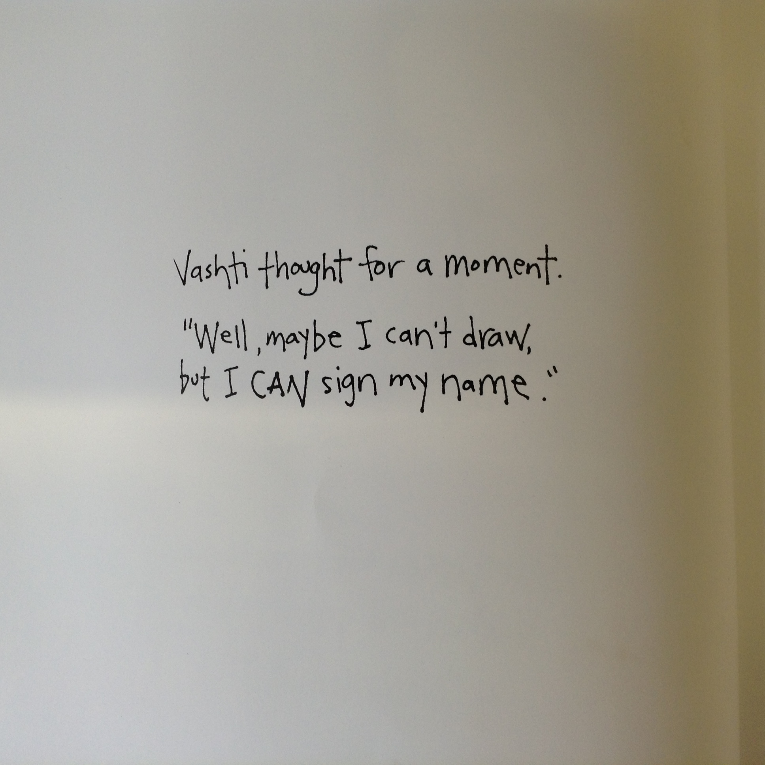

Slide 21
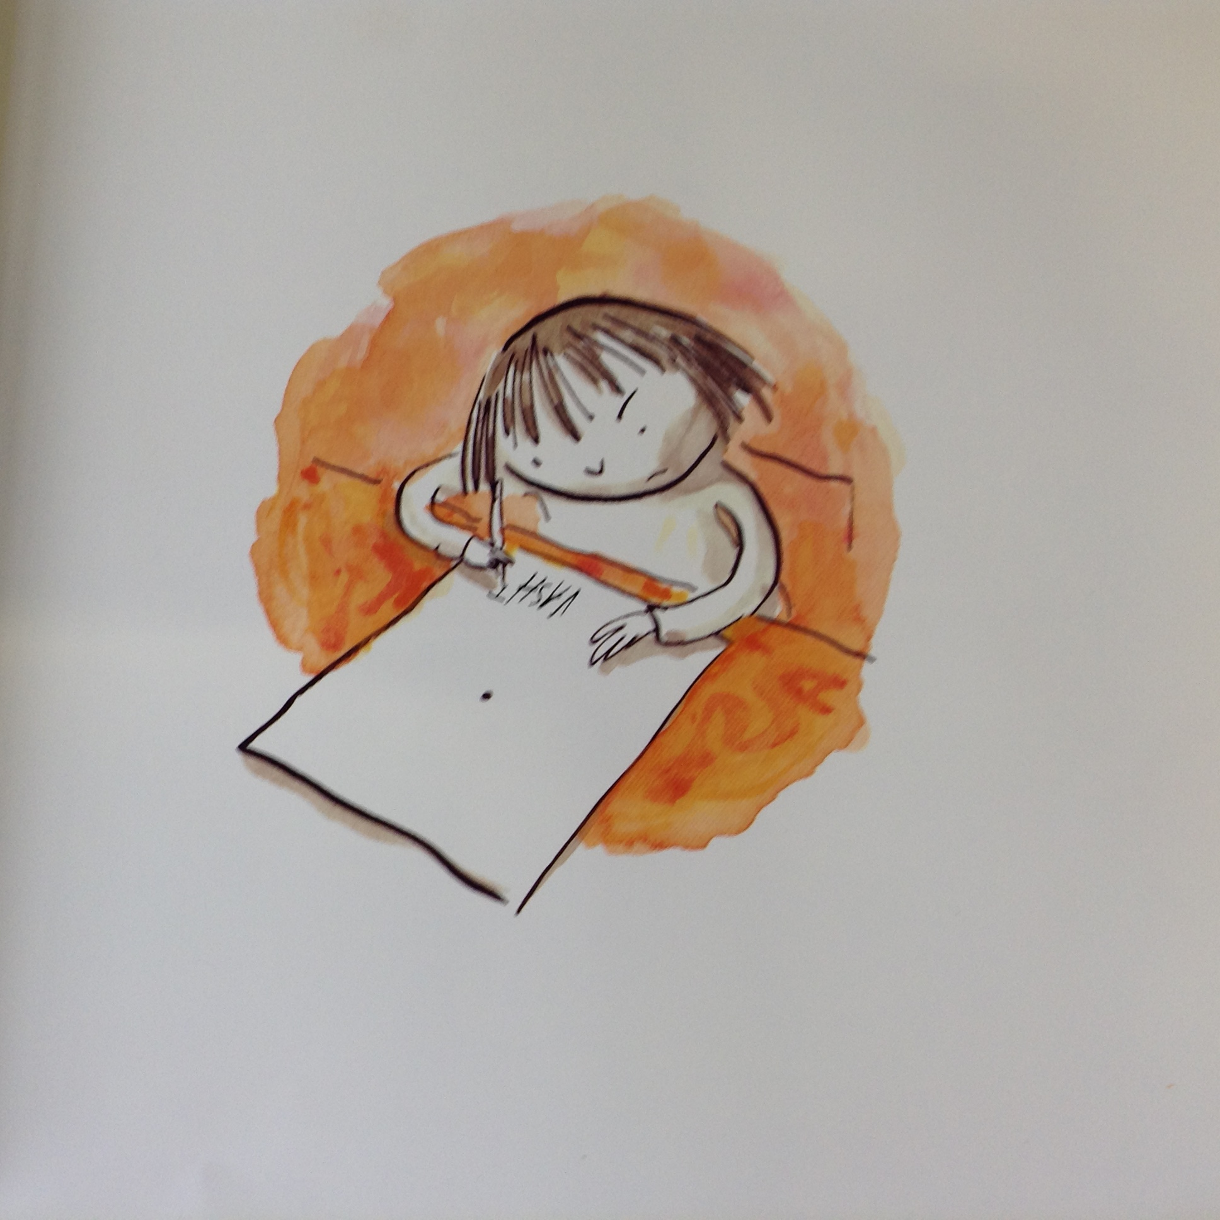

Slide 22


Slide 23
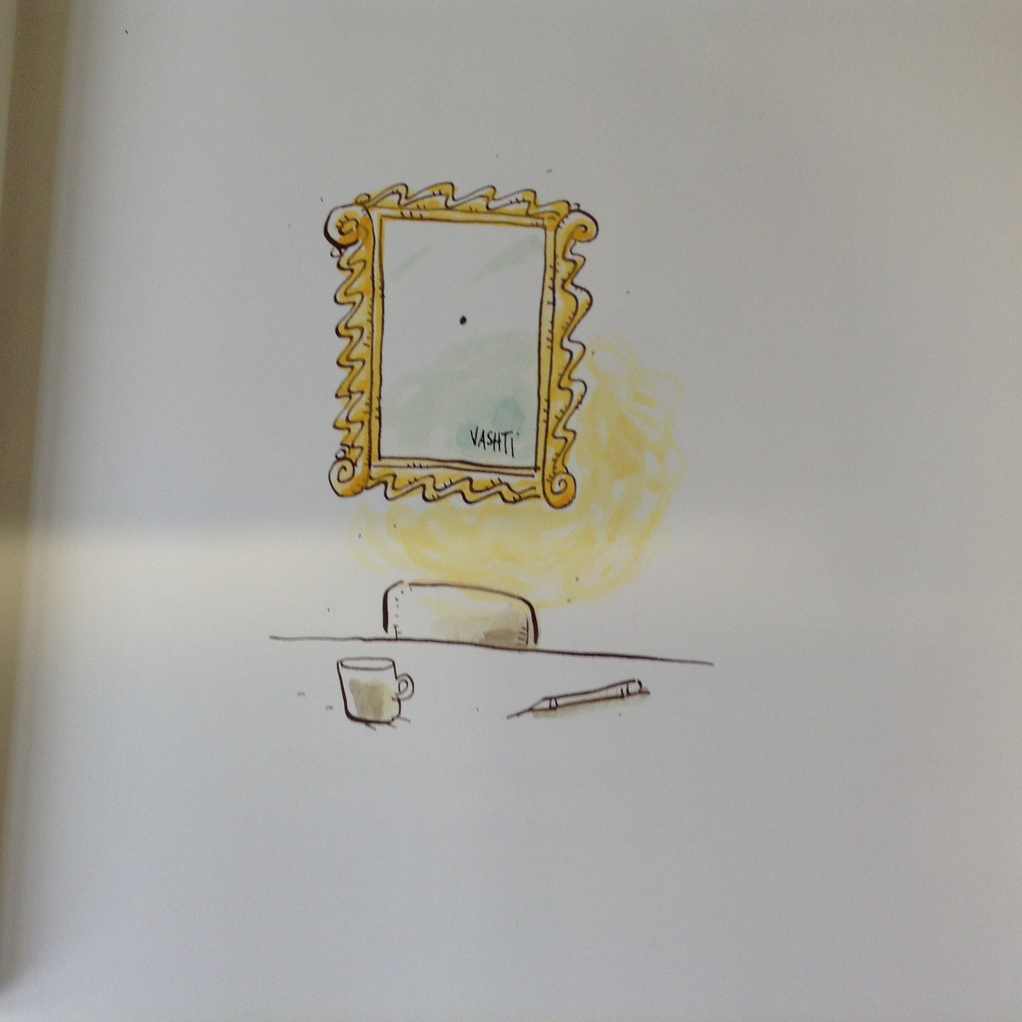

Slide 24
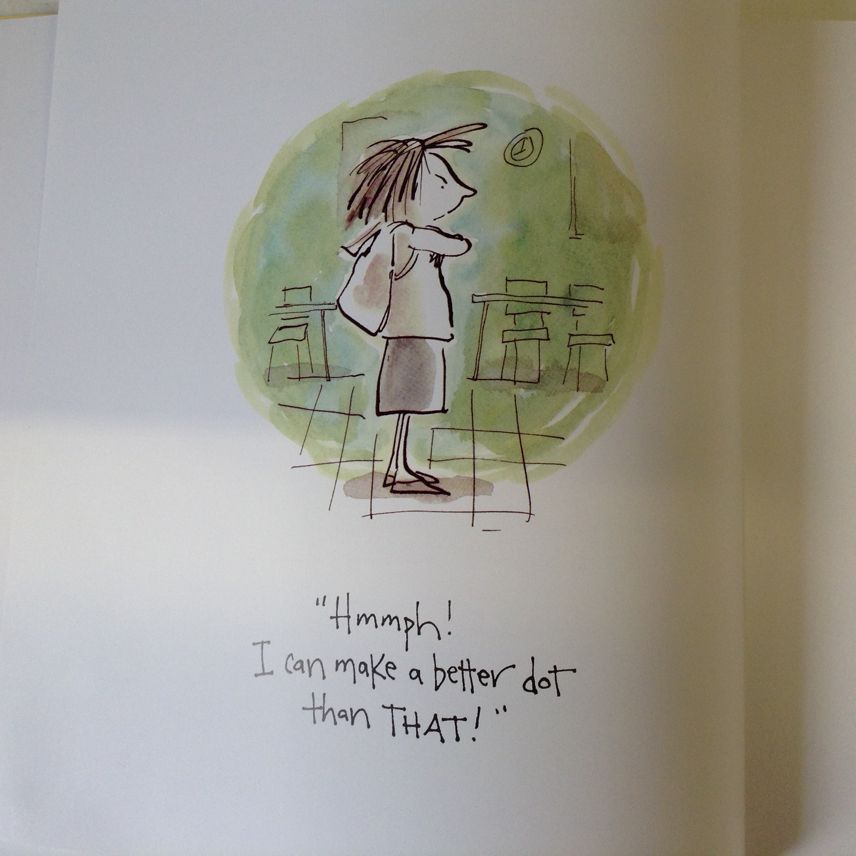

Slide 25
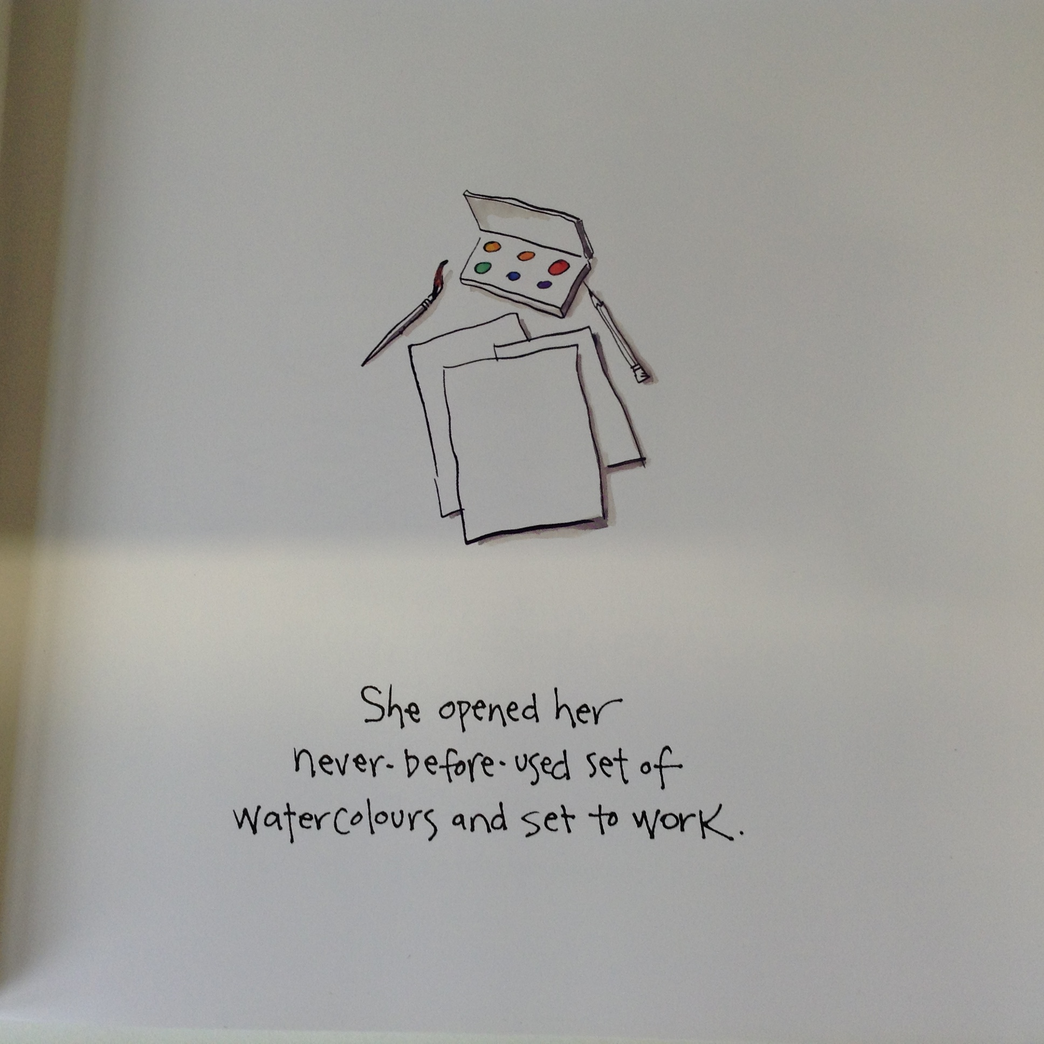

Slide 26
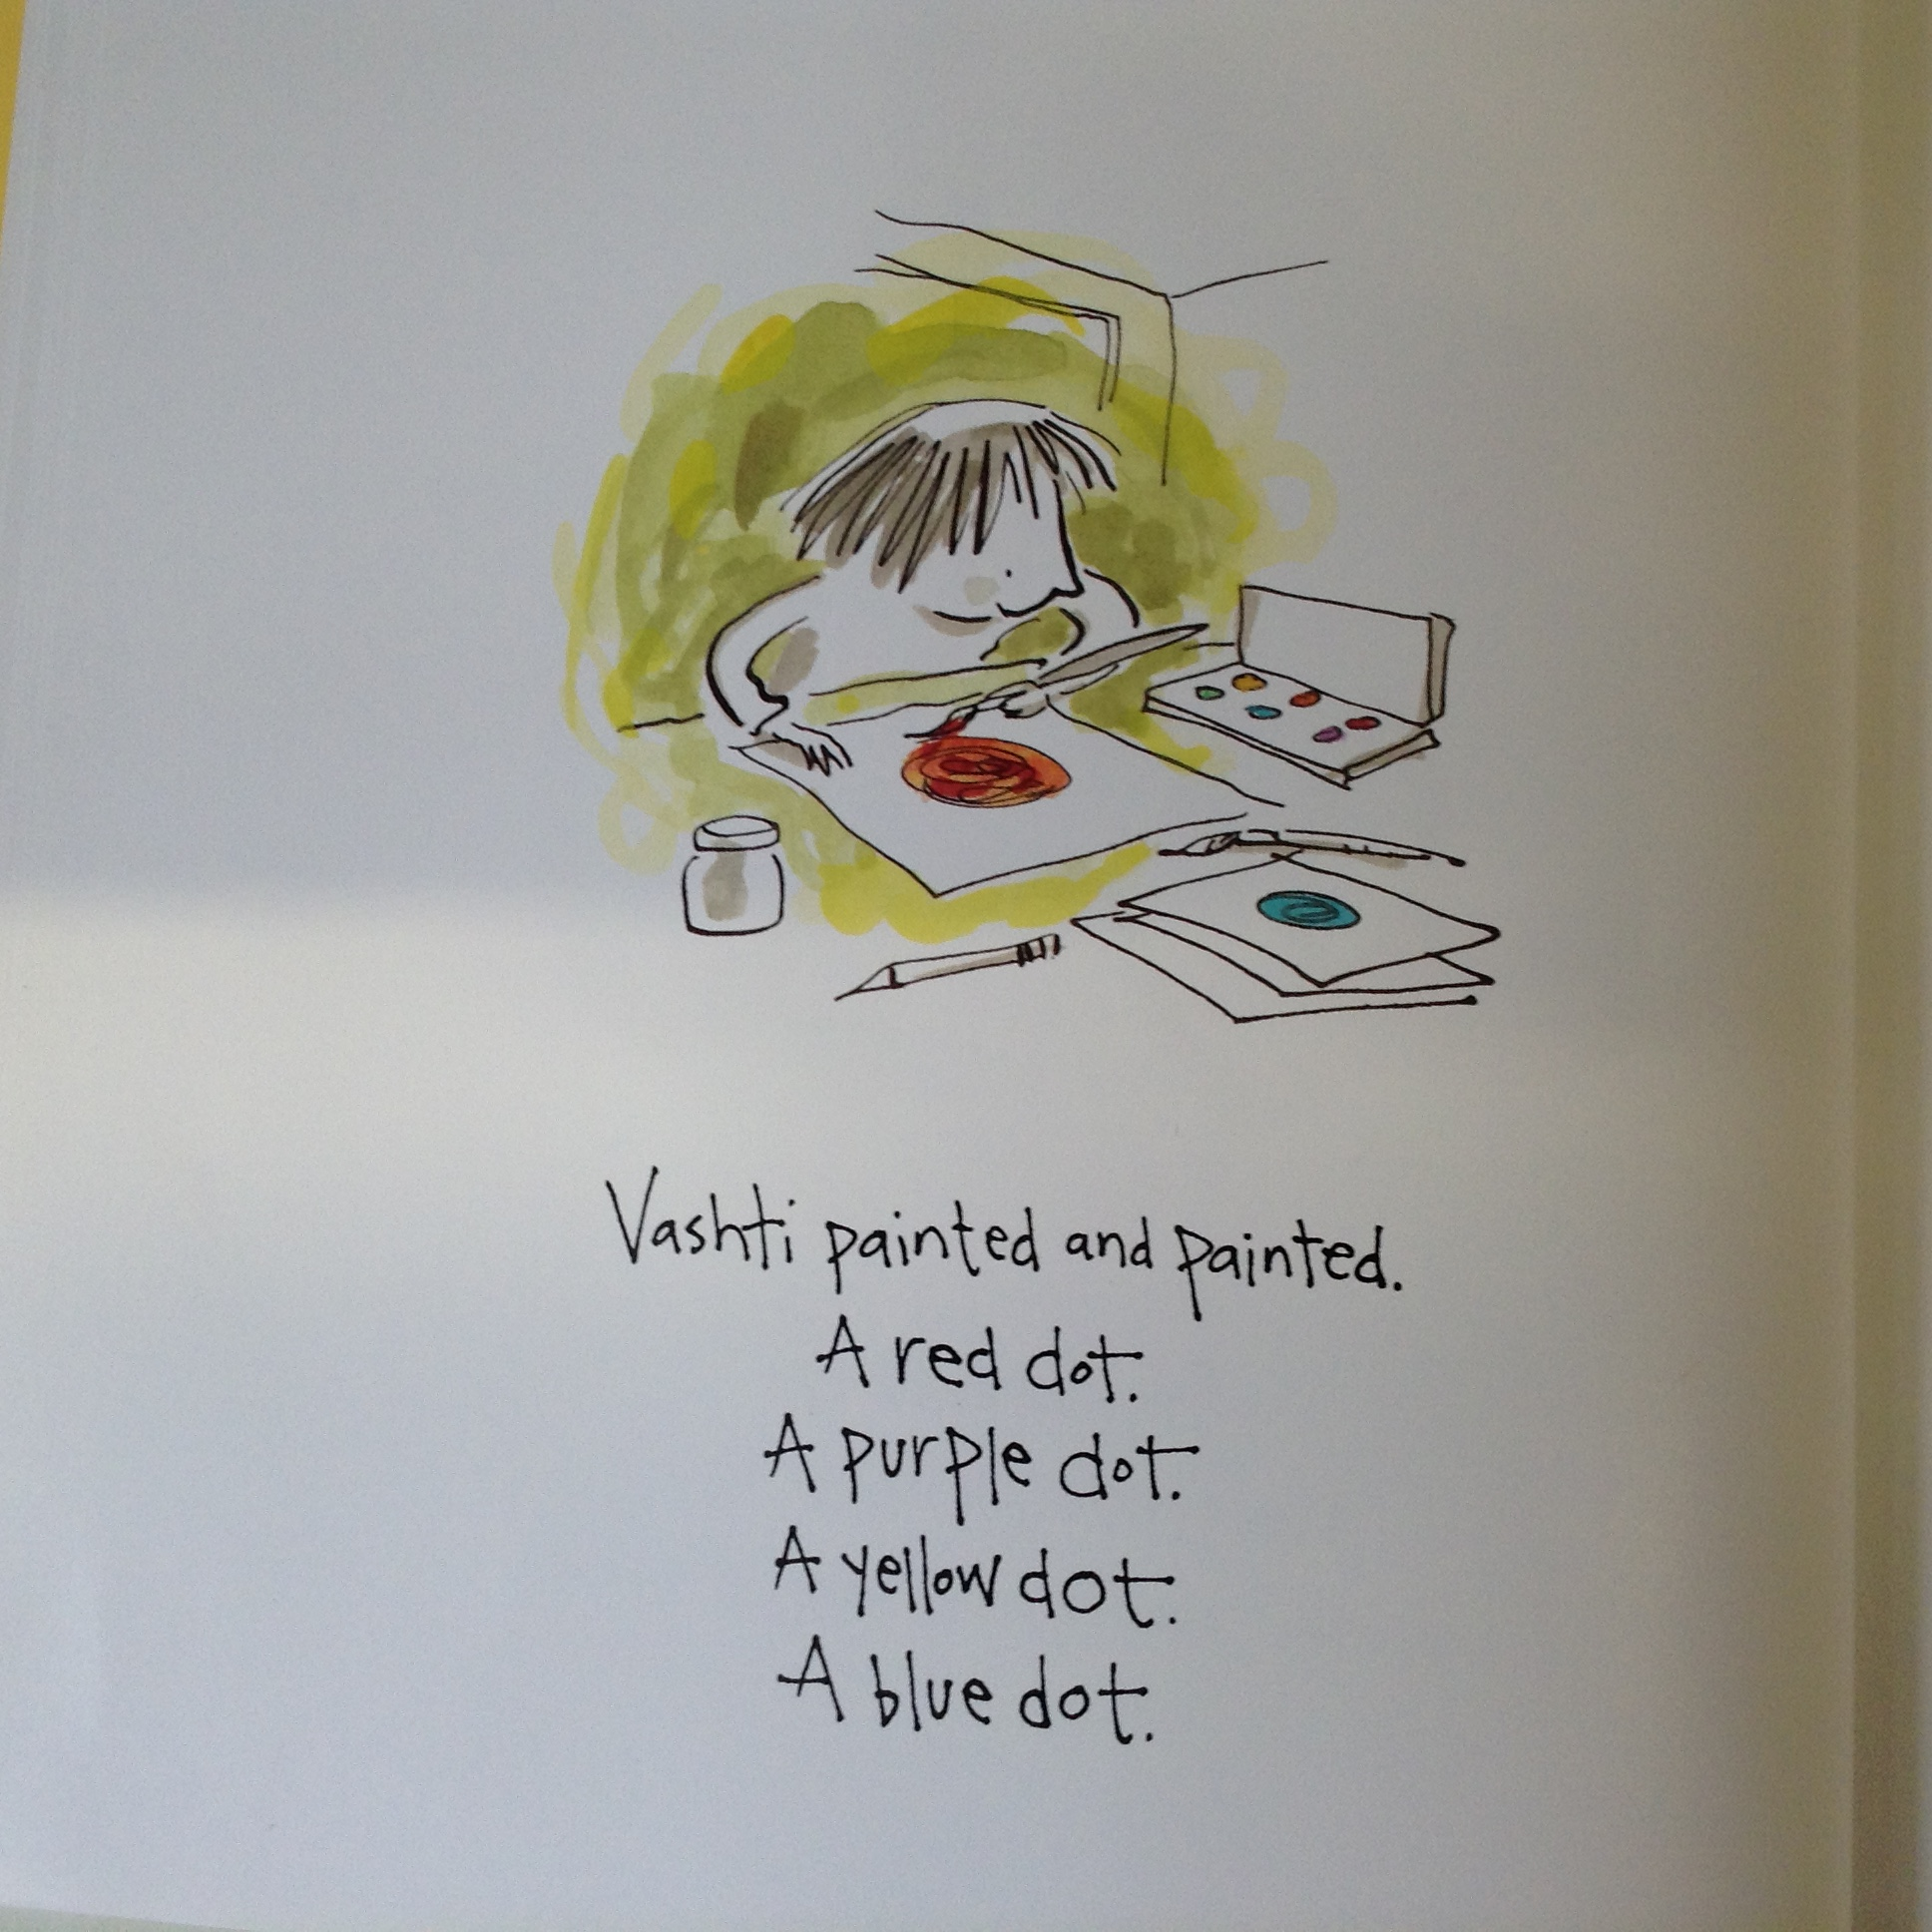

Slide 27
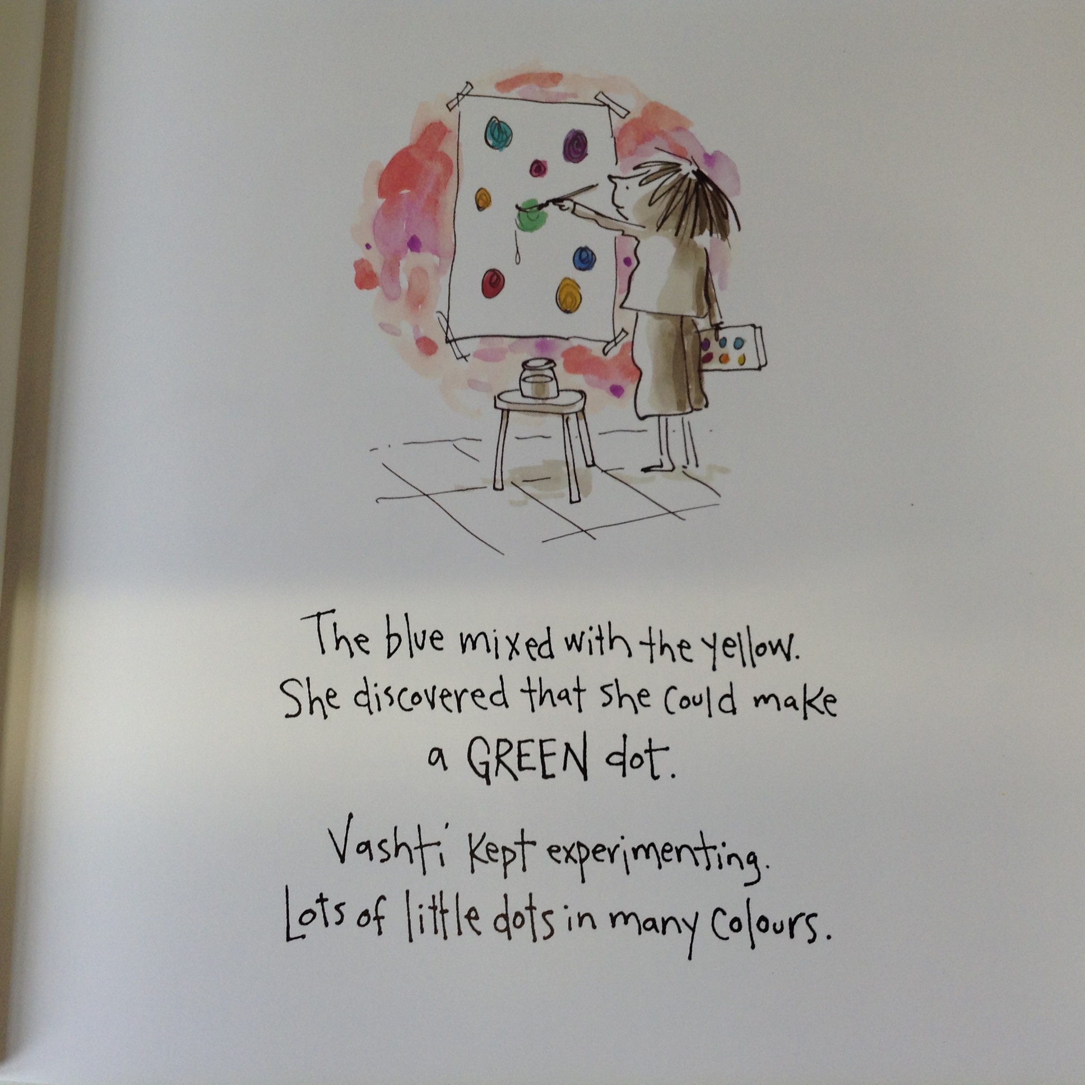

Slide 28
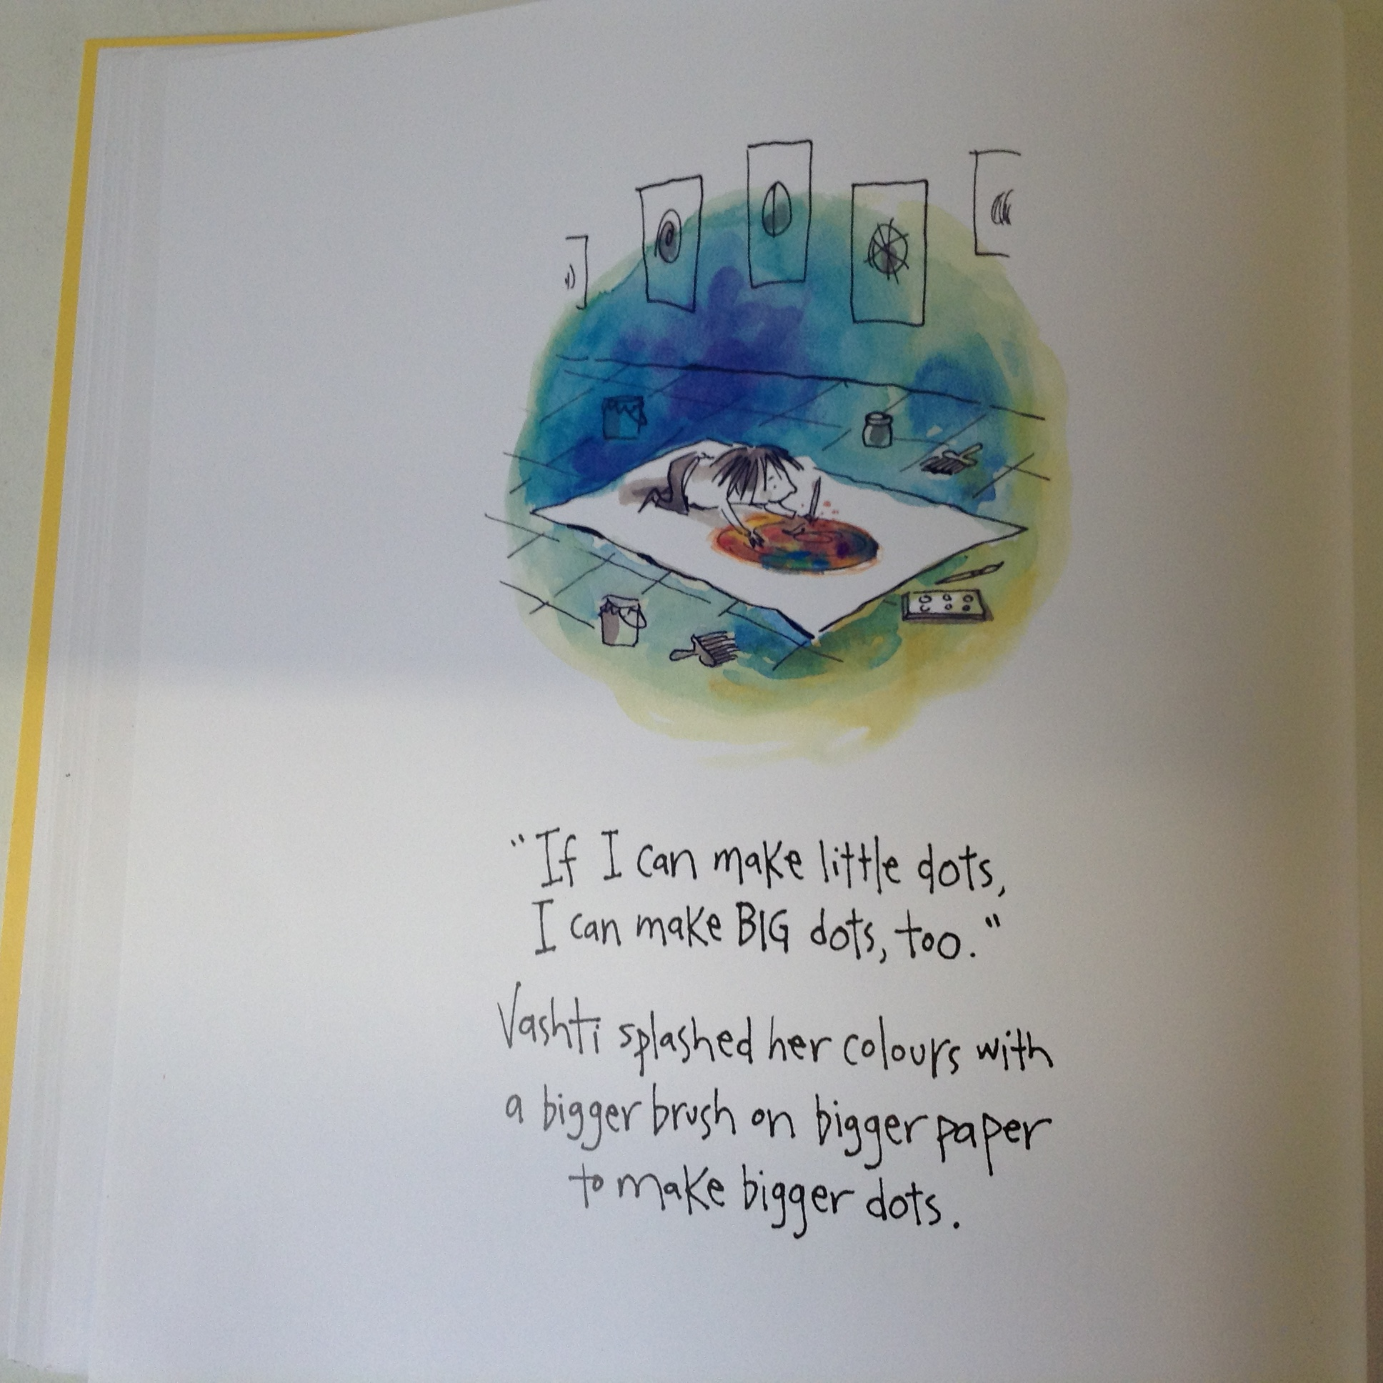

Slide 29
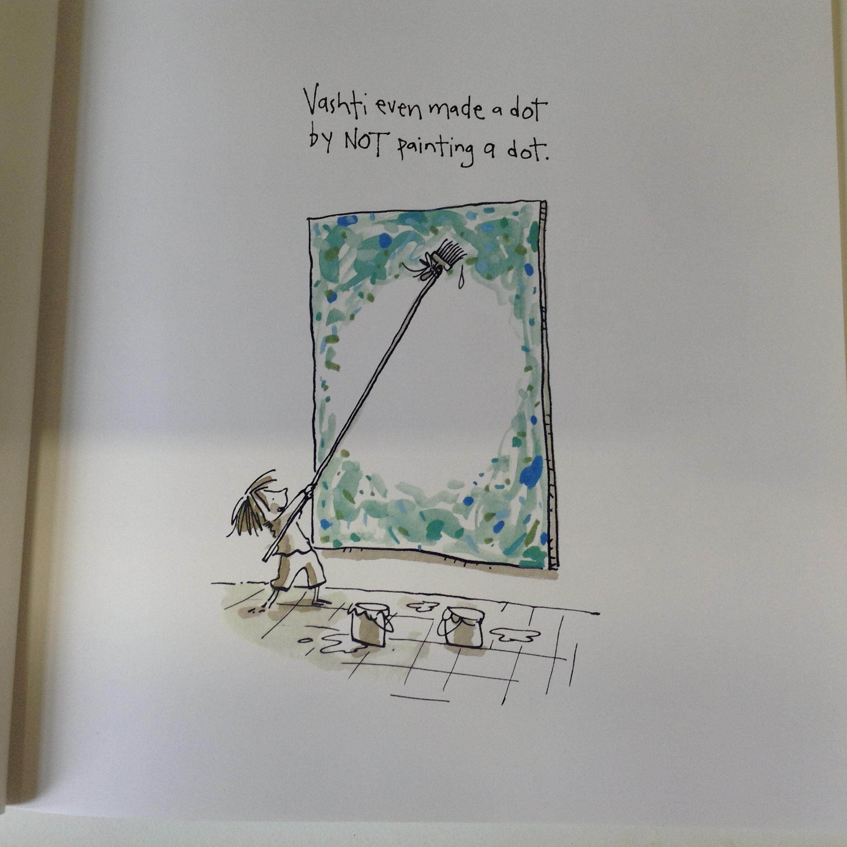

Slide 30
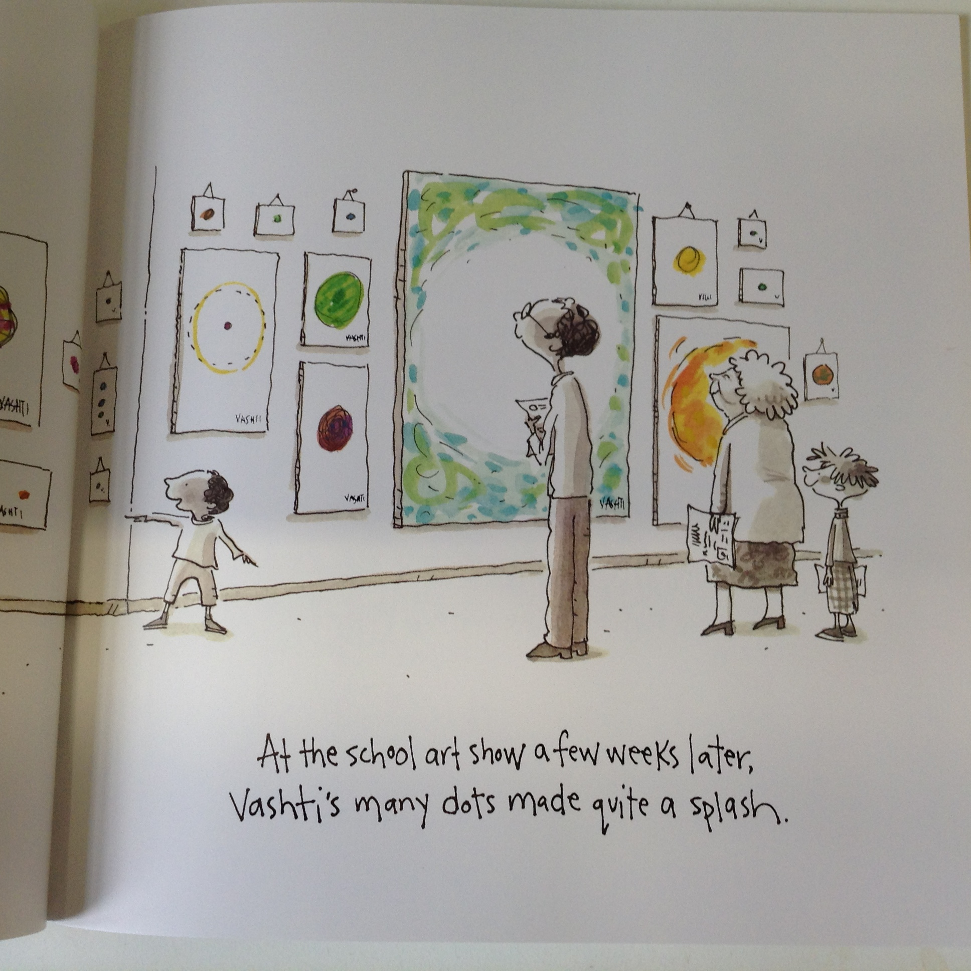

Slide 31
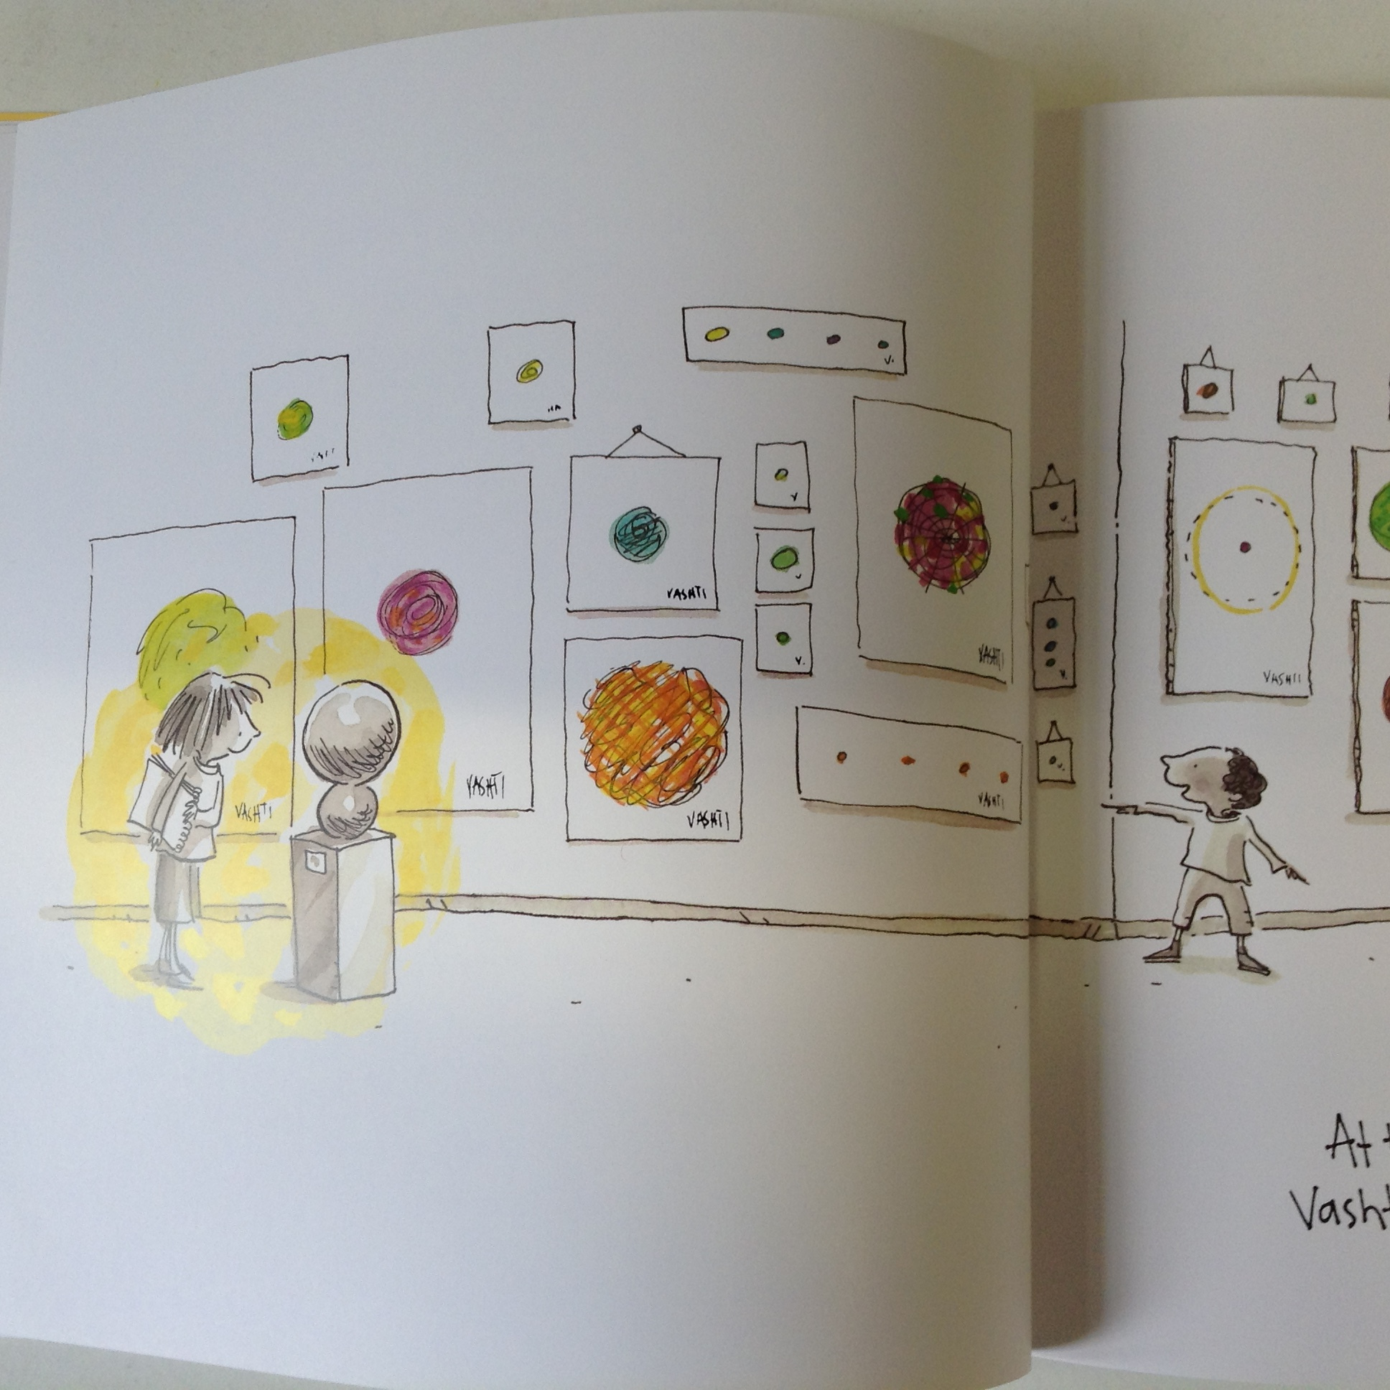

Slide 32
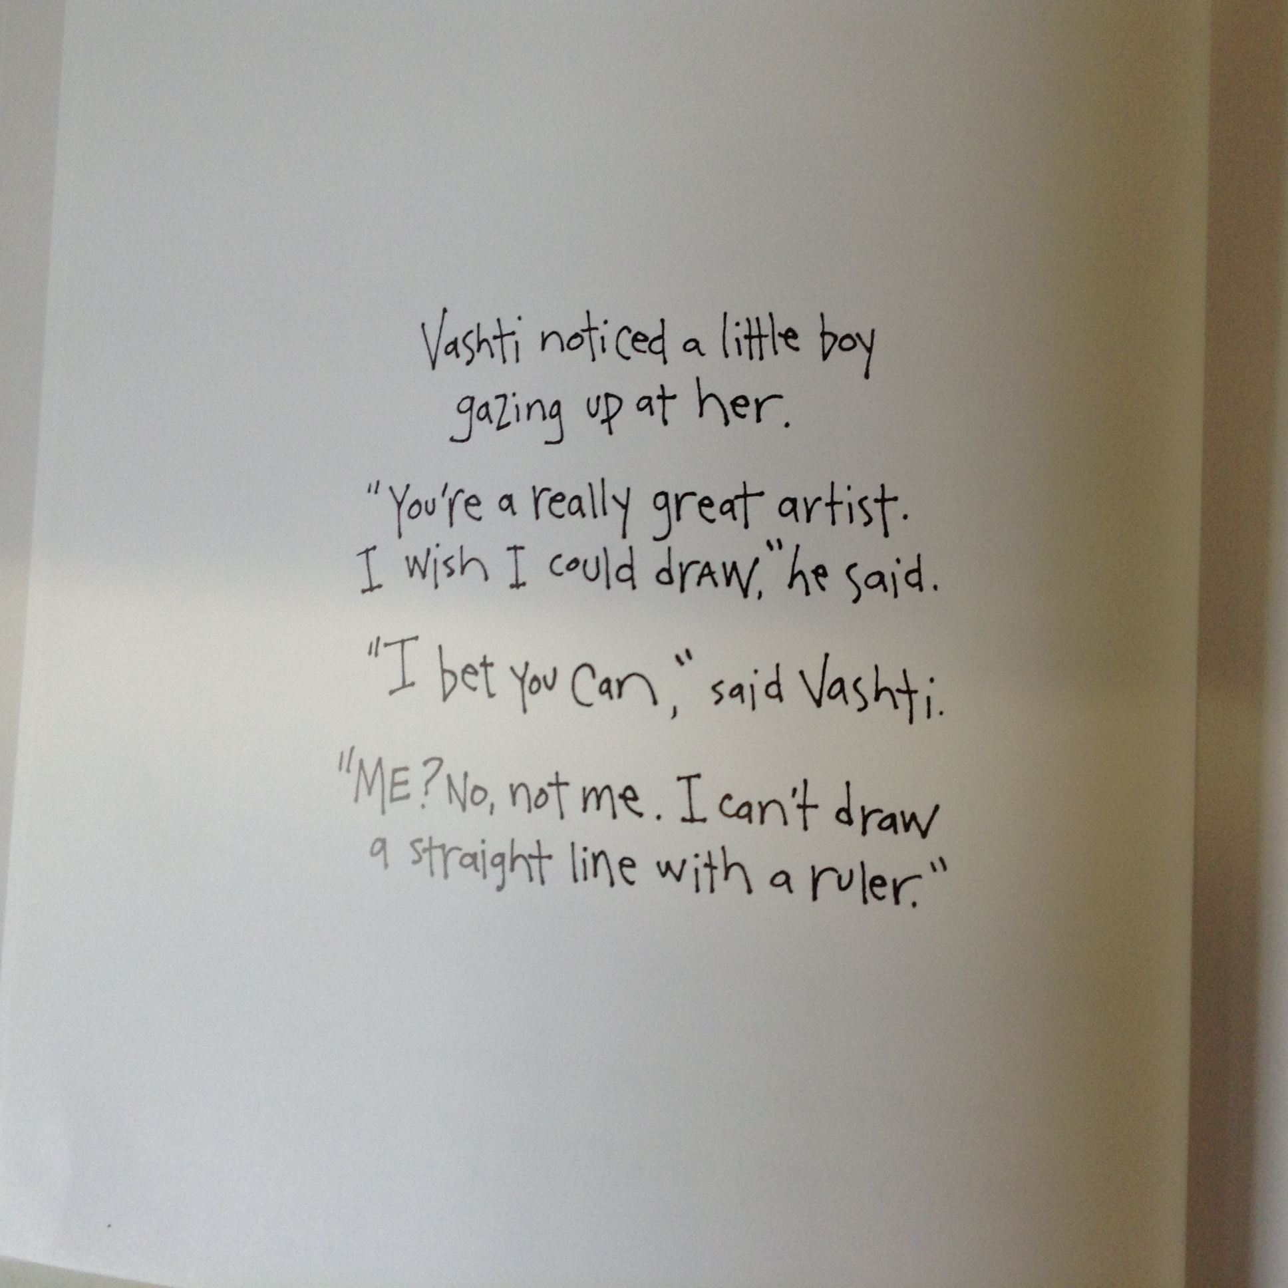

Slide 33
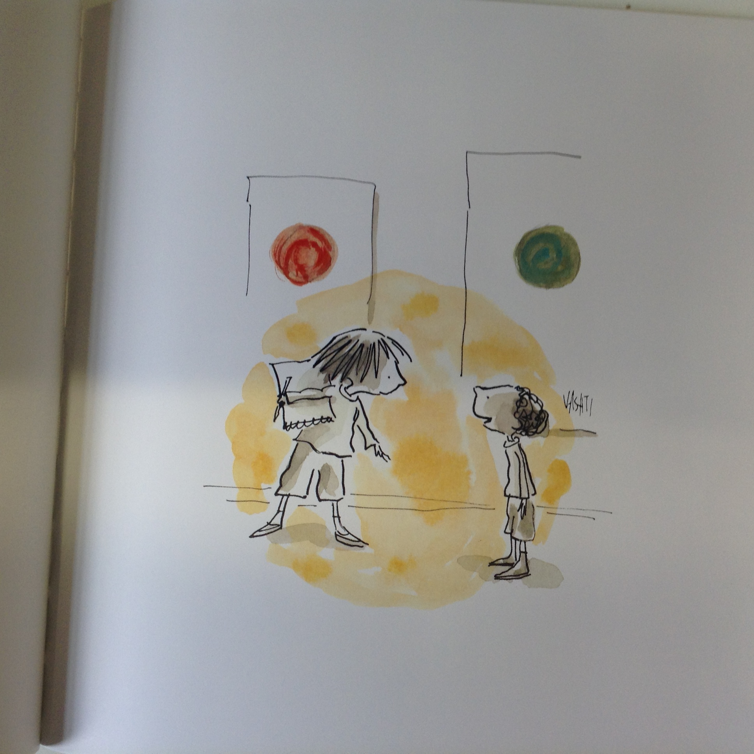

Slide 34
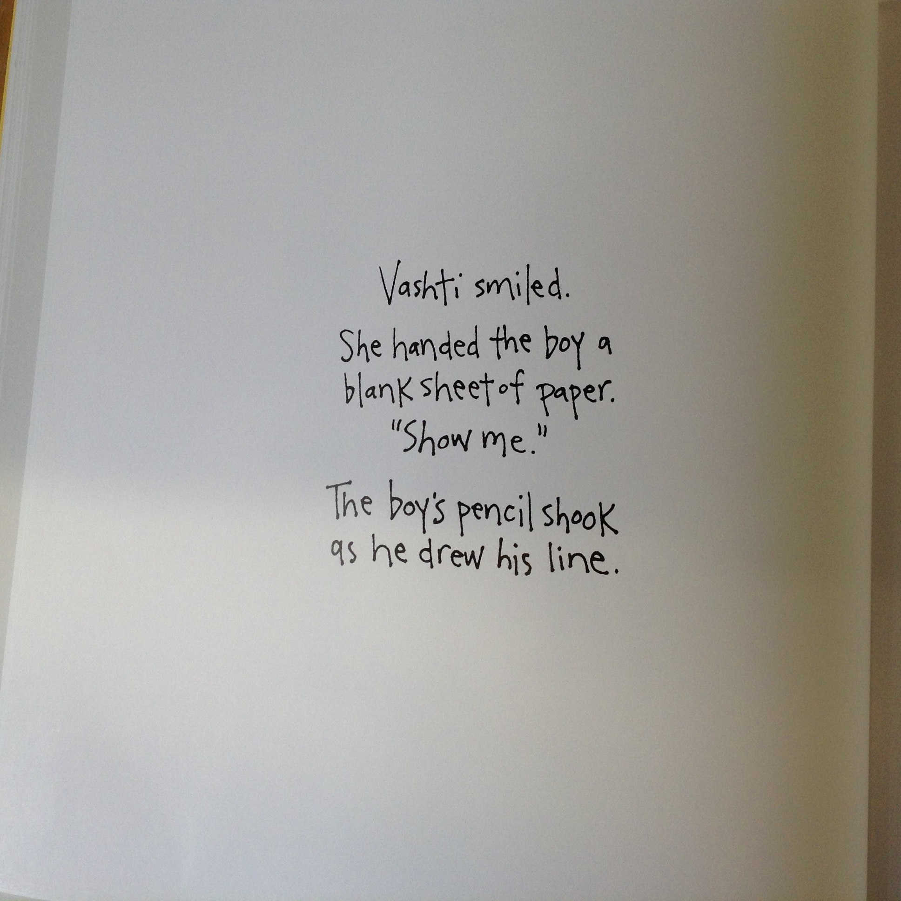

Slide 35
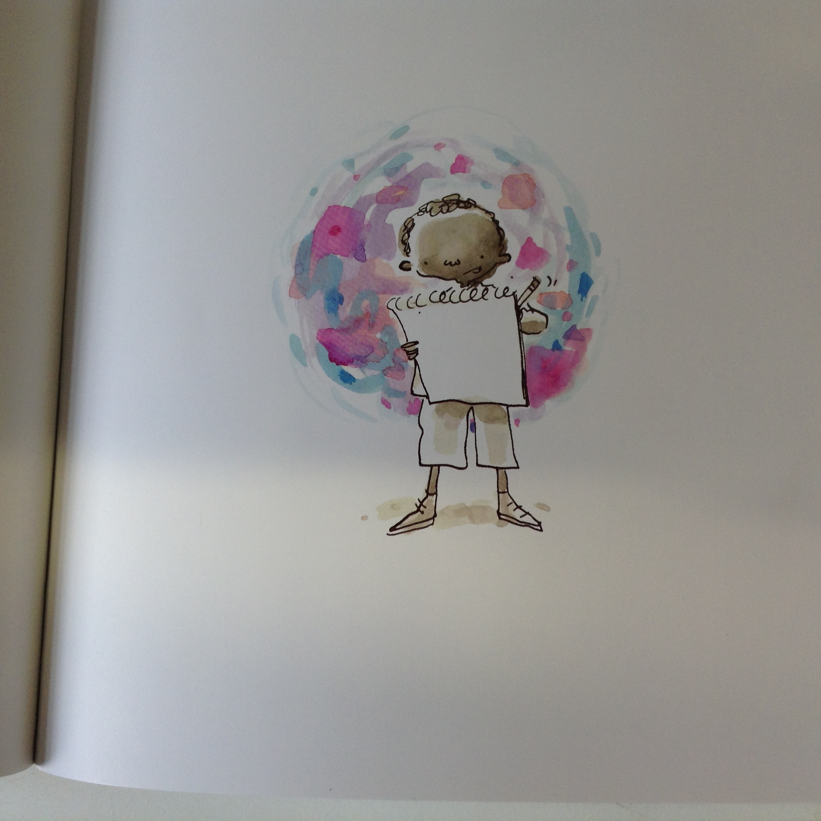

Slide 36
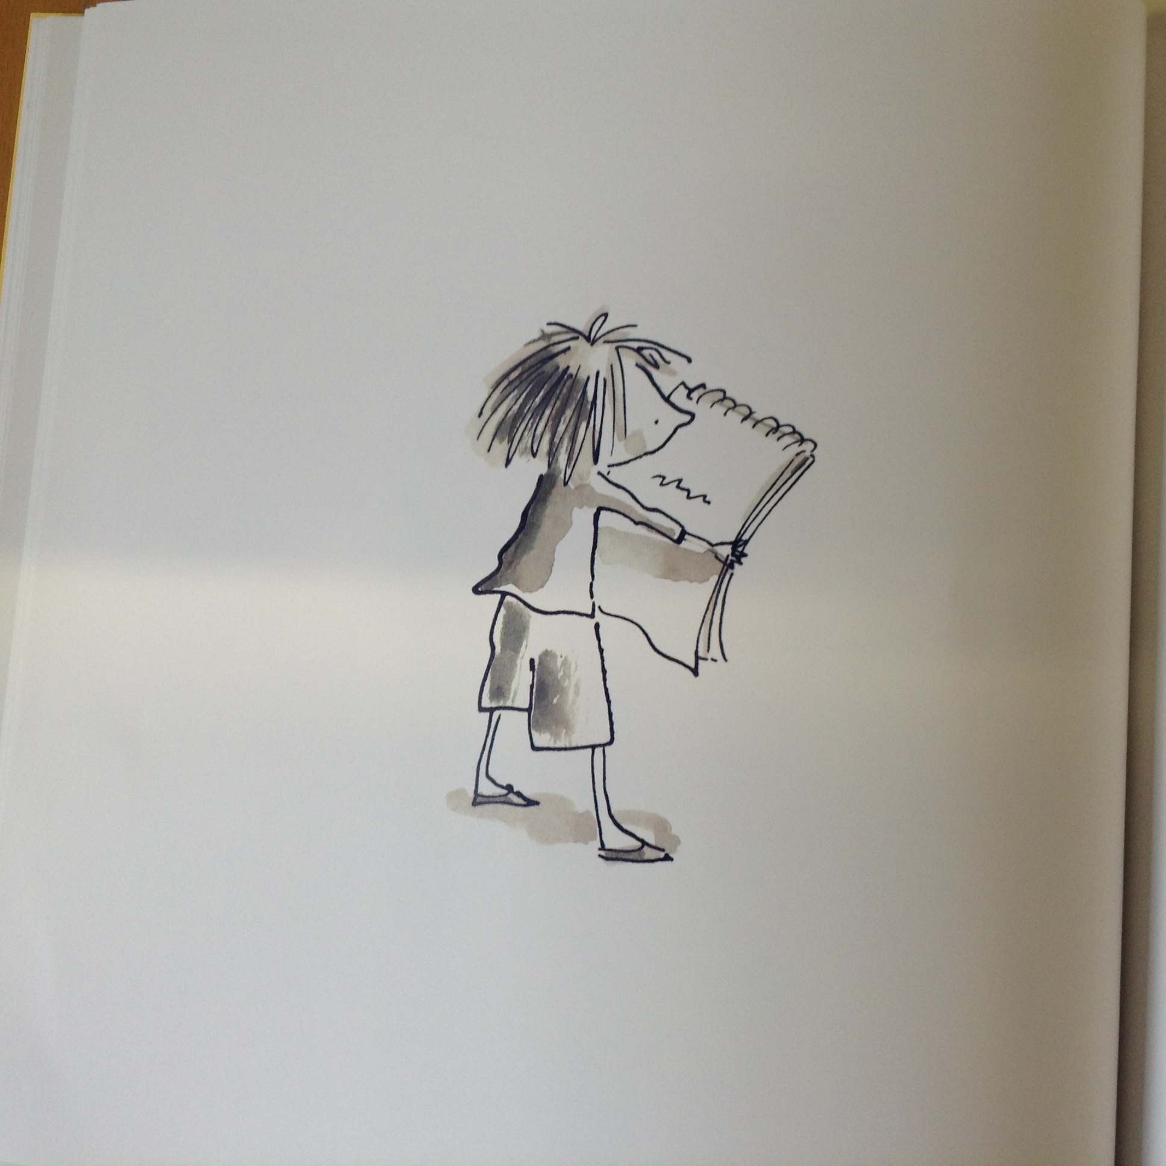

Slide 37
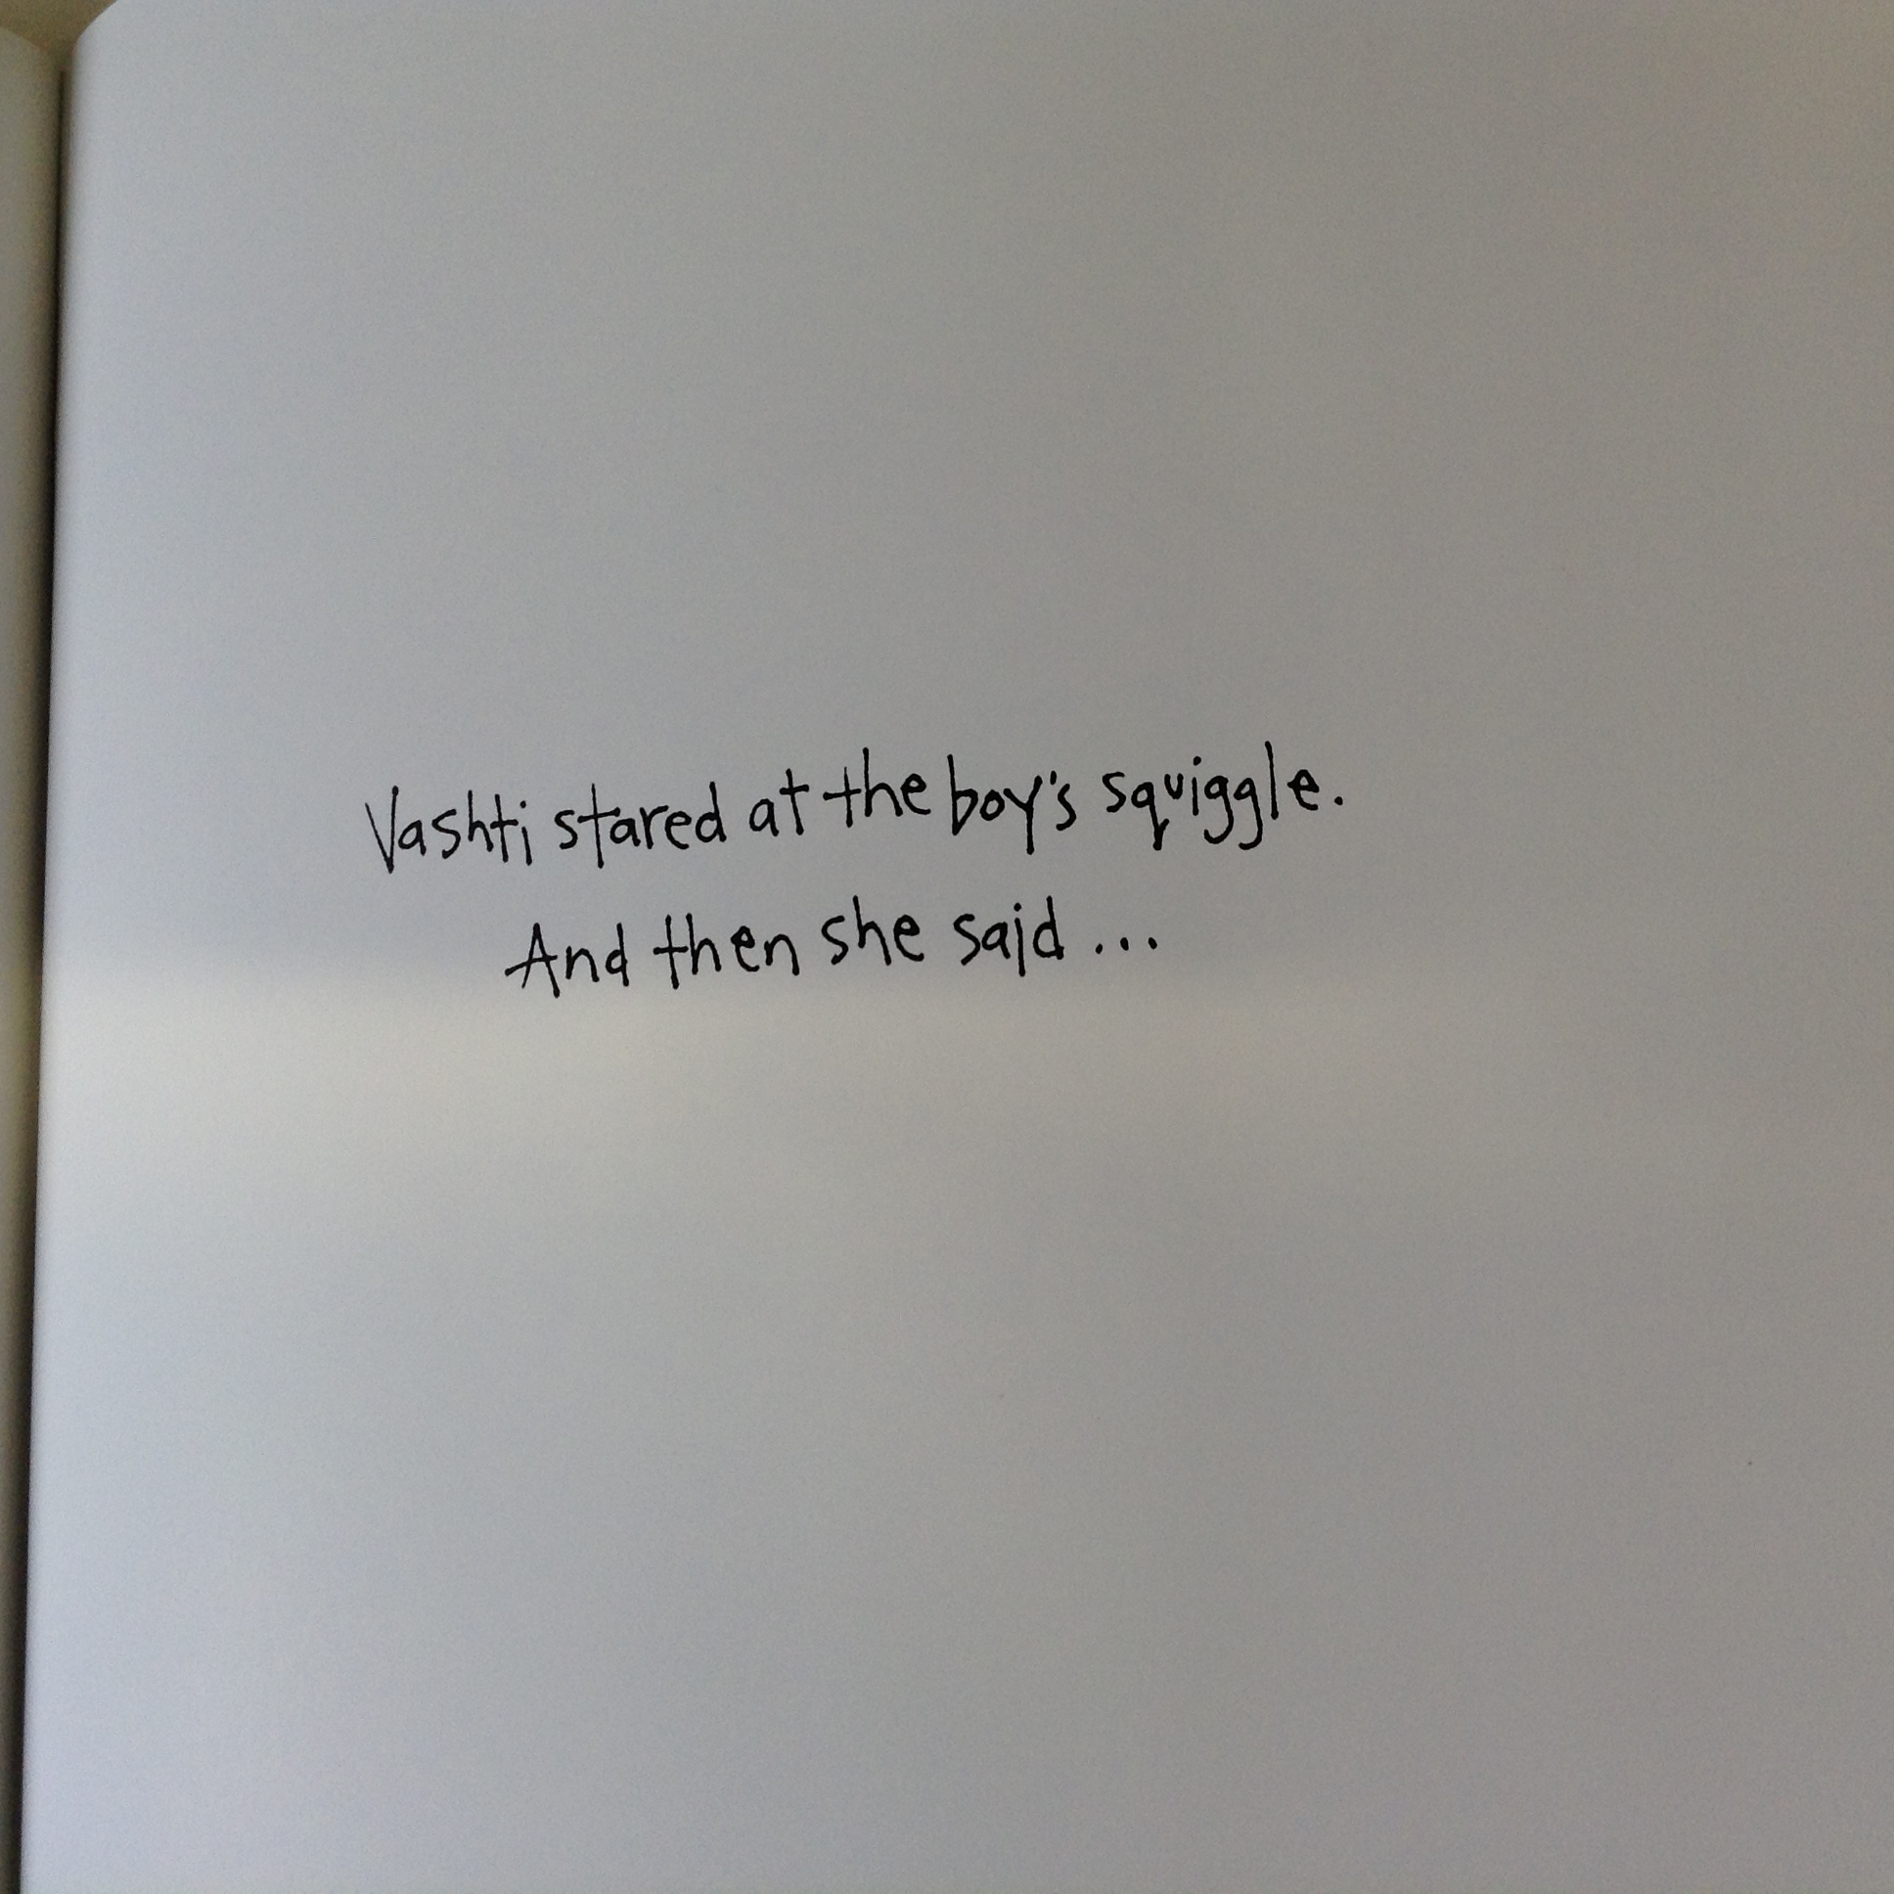

Slide 38


Slide 39
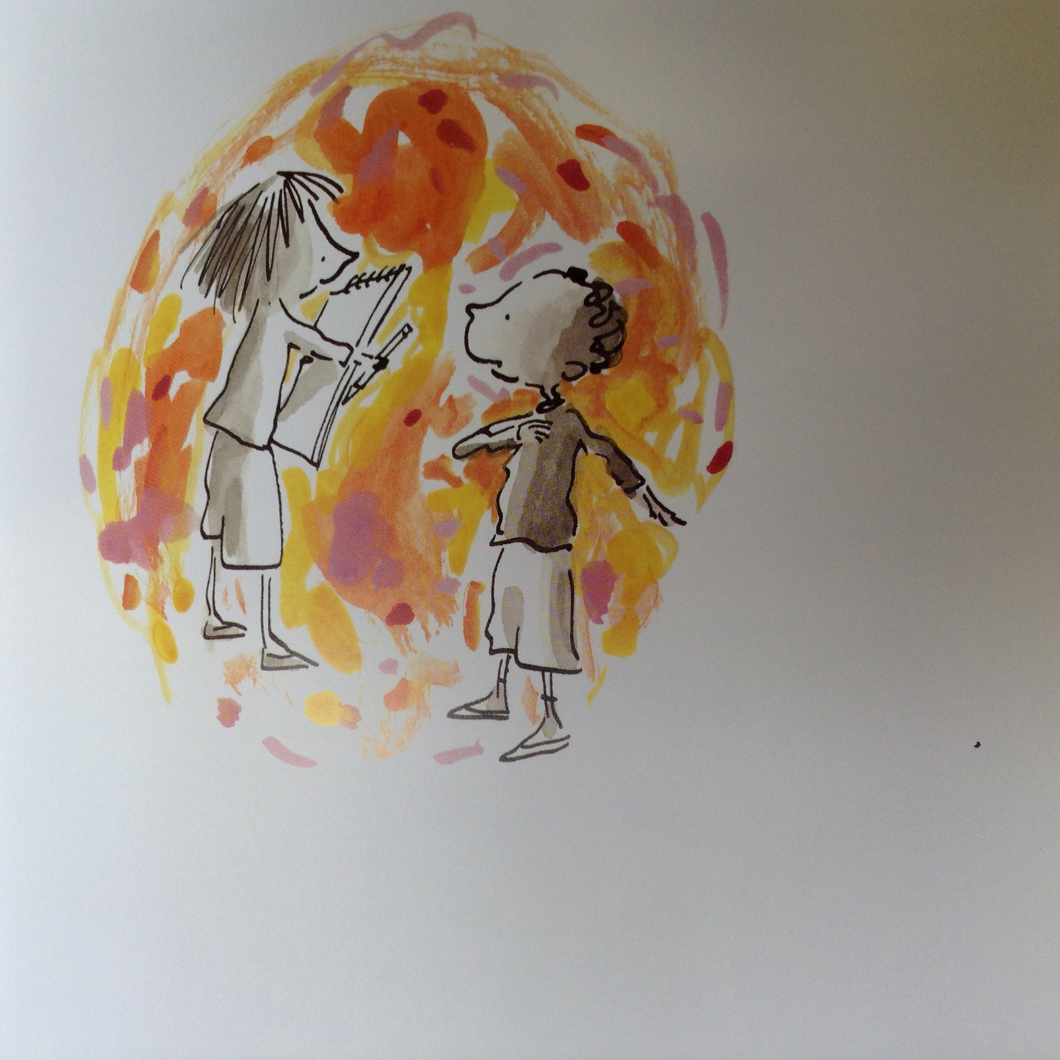

Slide 40
Having a Growth Mindset is looking forward to new challenges!

Slide 41
Having a Growth Mindset is keeping working at things that you find hard until they become easier.

Slide 42


Slide 43
Feed your brain!

