Slide 1
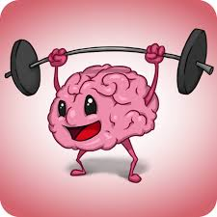
South Morningside Primary
Growth Mindset

Slide 2
What can YOU remember?

Slide 3
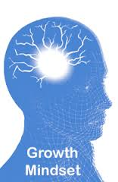
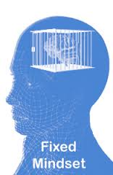
There are 2 kinds of ‘Mindset’………

Slide 4
What can YOU remember about a Fixed Mindset?

Slide 5
Fixed Mindset
I’m can either do it or I can’t do it.
When I get stuck, I give up.
I don’t like the challenge of new work
When I fail, I think that I’m no good

Slide 6
What can YOU remember about a Growth Mindset?

Slide 7
i
Growth Mindset
I can learn anything I want to.
When I get stuck, I keep going.
I like the challenge of new work
I can’t do it …yet

Slide 8
Let’s look at the key Growth Mindset messages.

Slide 9
We are all a mixture of Growth Mindset and Fixed Mindset.

Slide 10
We all think that we are good at some things and not good at others.

Slide 11
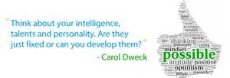
Growth Mindset is not just about school work- its about everything.
Notes:
Talk to a partner about different ways you could use Growth Mindset

Slide 12
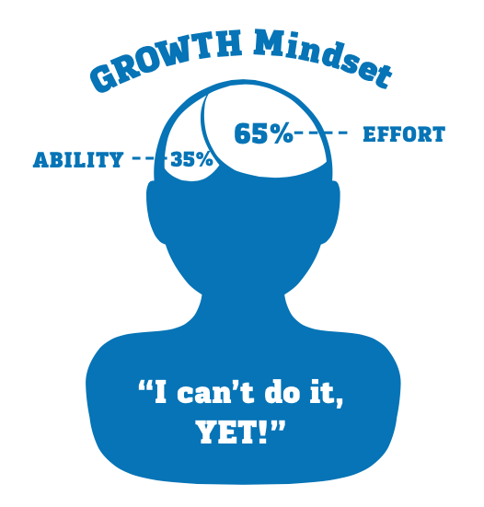
Challenges and setbacks make our brain grow

Slide 13
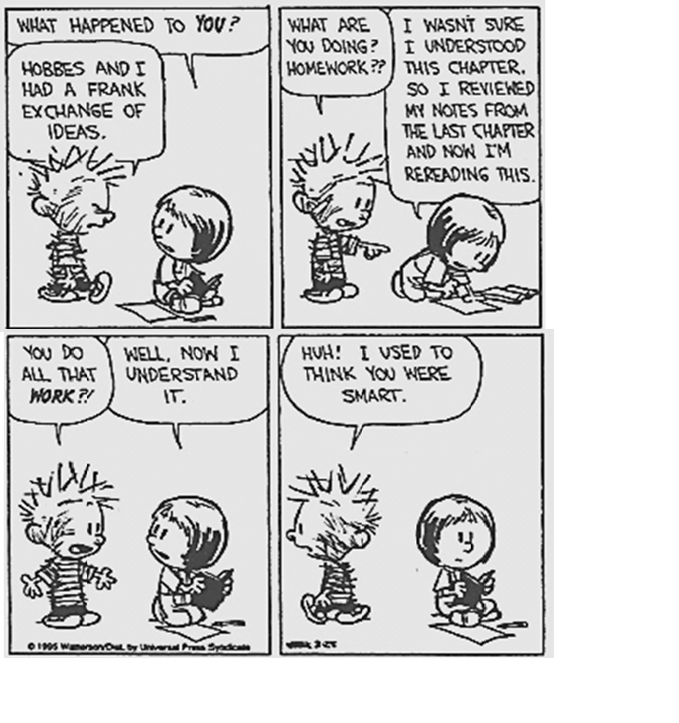
Putting lots of effort is a sign of a Growth Mindset

Slide 14
But………trying hard isn’t enough.
You have to try a new strategy
You have to ask for help when you are stuck

Slide 15


Slide 16


Slide 17
Callum Skinner was a pupil at South Morningside!
Chris Hoy said Callum was not the most talented cyclist when he was 12.
How did he win a Gold and a Silver medal at the Rio Olympics?
He had a Growth Mind-set!
He worked incredibly hard and he listened really carefully to his coaches when they told him how to improve.

Slide 18
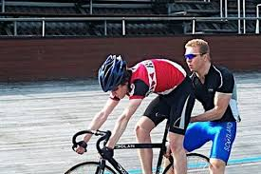

Slide 19
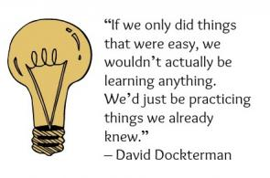
Learning new things is hard work!

Slide 20
How can this make a difference to you???

Slide 21
You have to recognise when you are using a Fixed Mindset and help yourself to develop a Growth Mindset in that subject.

Slide 22
What can you say to yourself to develop a Growth Mindset?

Slide 23
Don’t say:
“Not everyone is good at maths. I’ll just do my best.”

Slide 24
Do Say:
“When I learn how to do something new it grows my brain.”

Slide 25
Don’t say:
“It’s too hard. I’m giving up.”

Slide 26
Do Say:
“That feeling of maths being hard is the feeling of my brain growing.”

Slide 27
Don’t say:
“I can’t do it.”

Slide 28
Do say:
“I can’t do it ……yet.”

Slide 29

The power of yet
Notes:
You tube- sesame street- Janelle Monae- power of yet

Slide 30
Feed your brain!

