Slide 1

Speedy Sounds
Read the sound and say the rhymes.

Slide 2
Set 1 Sounds
Consonant Digraphs

Slide 3
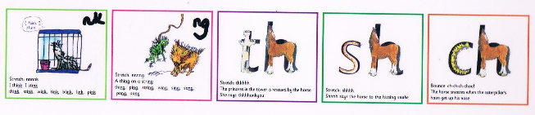
Sh said the horse to the hissing snake.
sh

Slide 4
The princess in the tower is rescued by the horse.
th

Slide 5
The horse sneezes when the caterpillars hairs get up it’s nose
ch

Slide 6
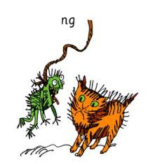
Thing on a string

Slide 7
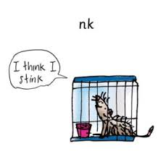
I think I stink

Slide 8
Set 2 Sounds
Vowel Digraphs

Slide 9
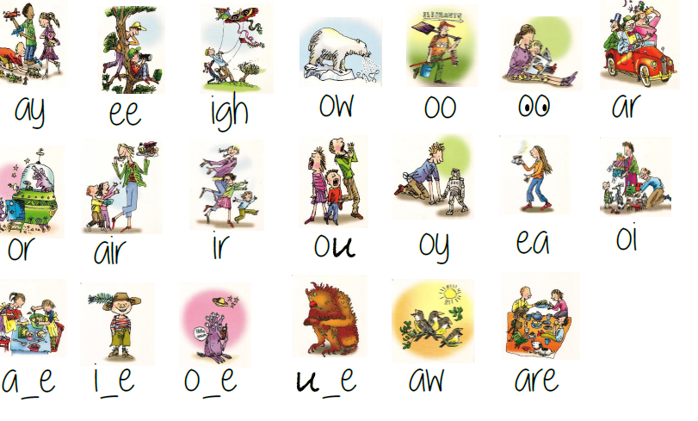
May I Play

Slide 10
What can you see?

Slide 11
Fly high

Slide 12
Blow the snow

Slide 13
Poo at the zoo

Slide 14
Shout it out

Slide 15
Toy for the boy

Slide 16
Set 3 Sounds
Vowel Digraphs

Slide 17
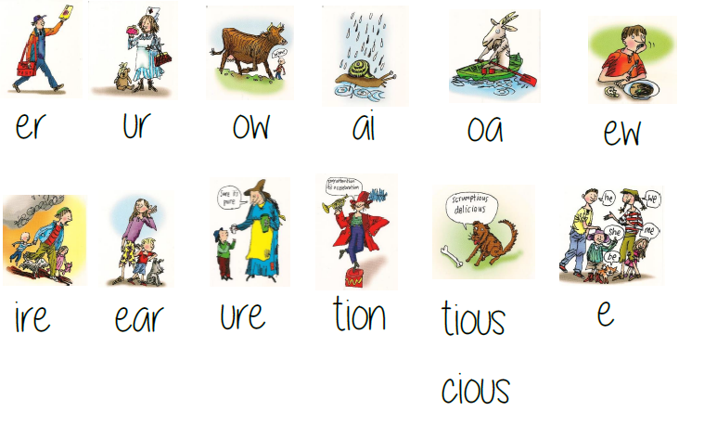
Snail in the rain

Slide 18
Cup of tea

Slide 19

I am shy
y

Slide 20
Goat in a boat

Slide 21
Chew the stew

Slide 22
Brown cow

Slide 23
Spoil the boy

Slide 24
Yawn at dawn

Slide 25
Magic e Sounds

Slide 26
Make a cake

Slide 27

Here is Eve
e-e

Slide 28
Like the Smile

Slide 29
Phone home

Slide 30
Huge brute

