Slide 1


What makes South Morningside special?
Reflecting on our vision, values and rules

Slide 2
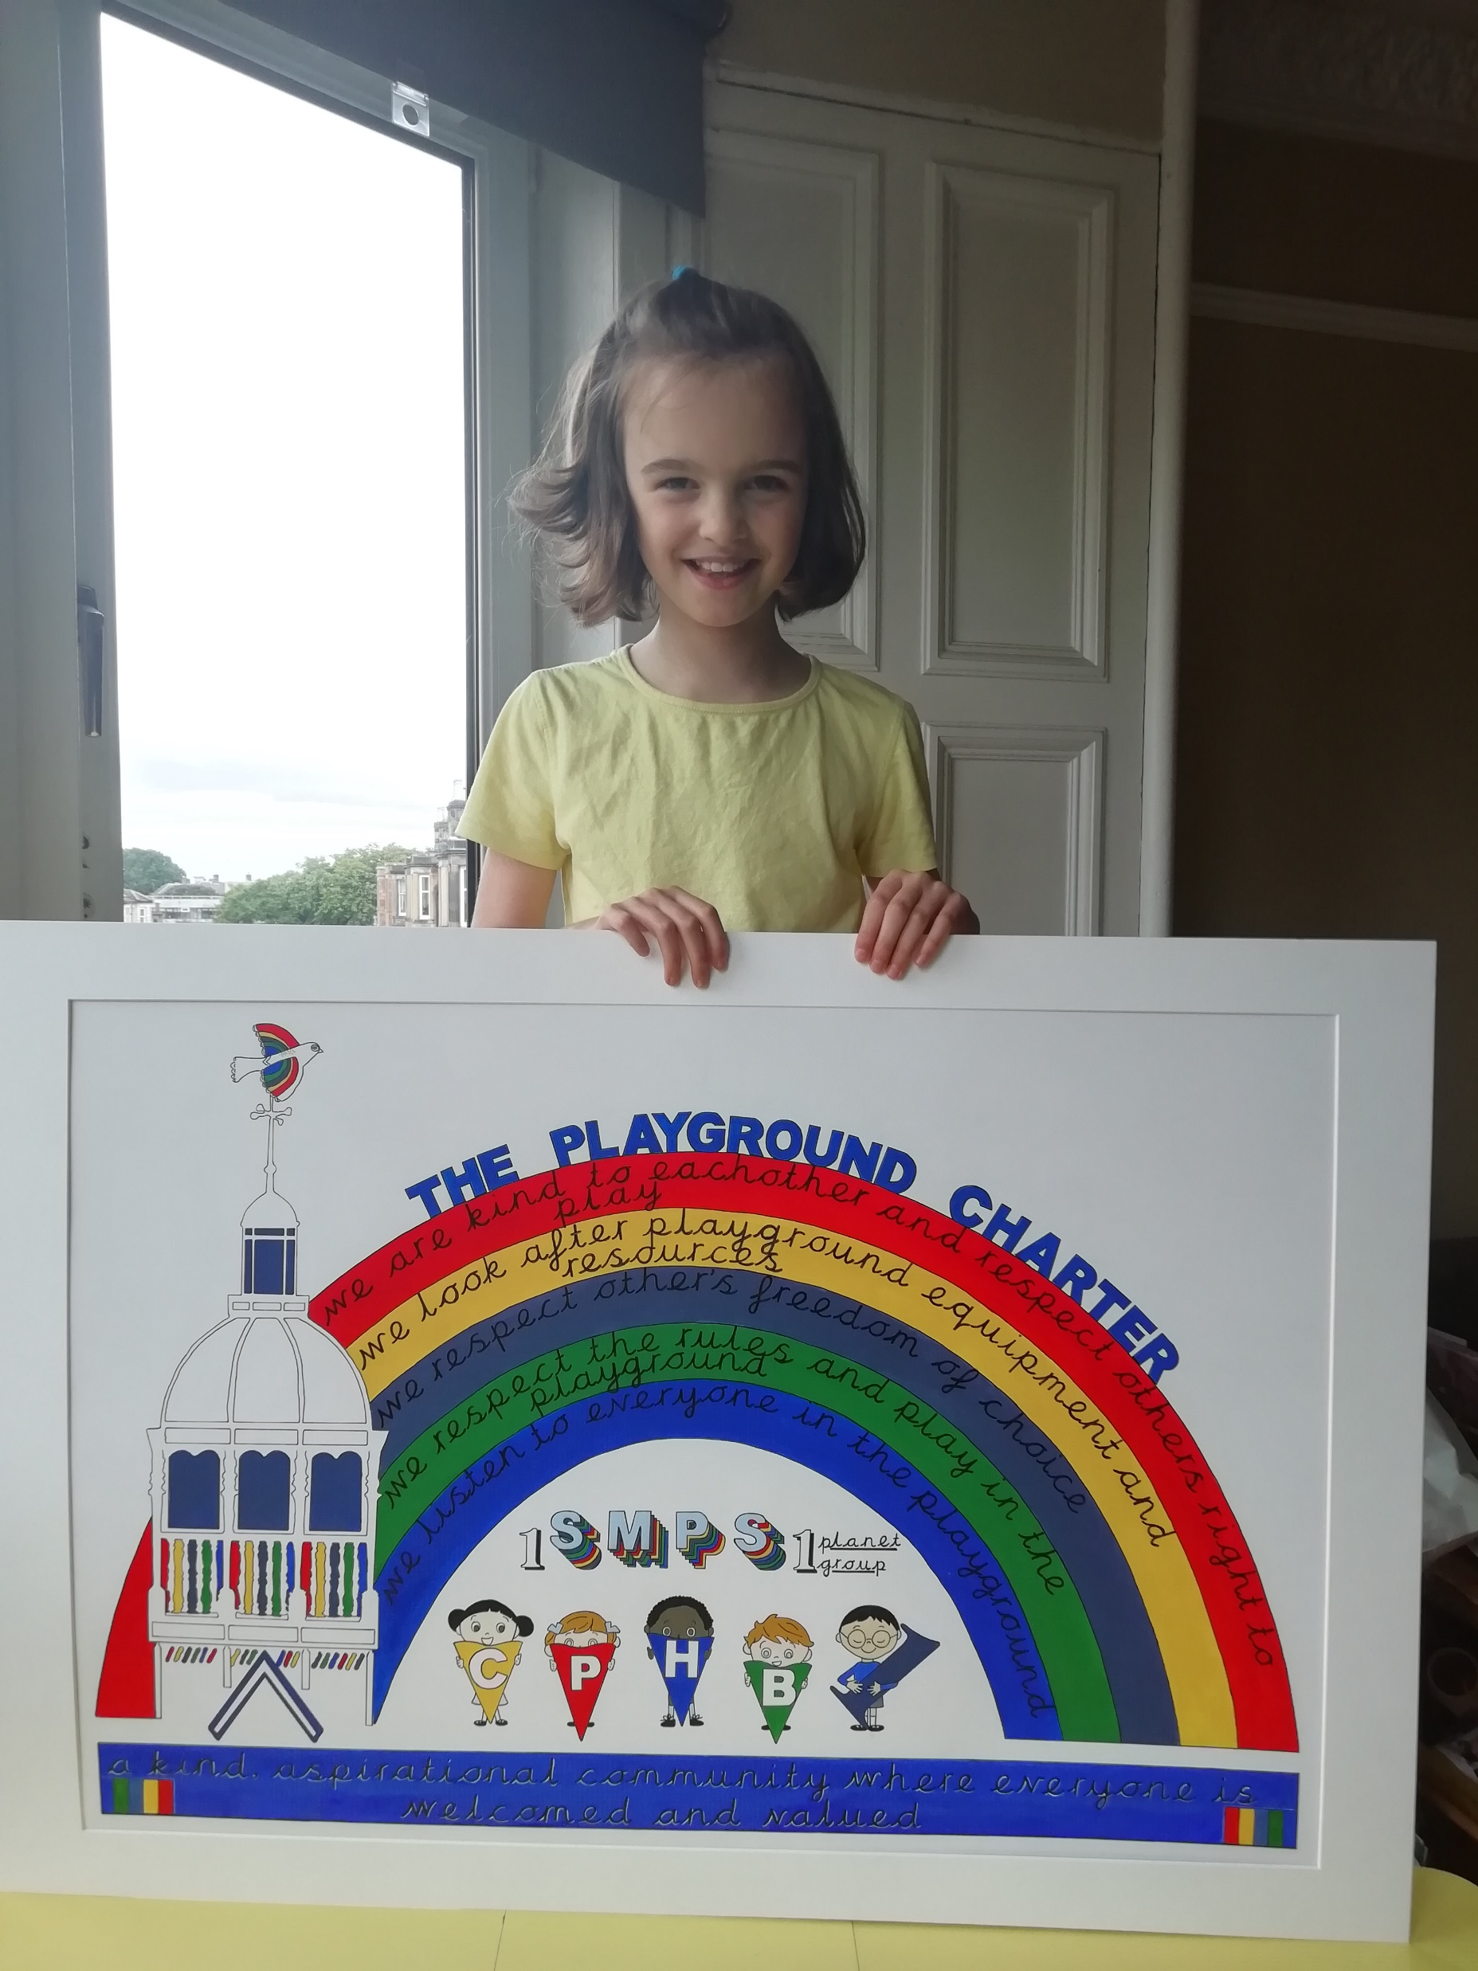
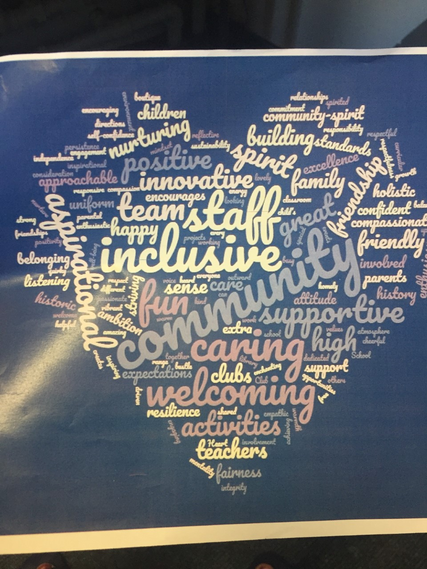

Our vision, values and aims- the journey..

Slide 3
South Morningside Primary School
“be kind, be fair”
A kind, aspirational community where everyone is welcomed and valued

Slide 4
Our vision
South Morningside Primary School aspires to…..
Be an inclusive and positive school at the heart of our community
Enable learners to achieve their full potential following an appropriately challenging, innovative, creative and inspirational curriculum
Develop independent learners who are confident, resilient, active, creative and well prepared for their future lives.
Encourage all children to be responsible local and global citizens who make a positive impact on the world
Value and involve all members of the school family, guided by an ethos of collaboration, communication, kindness and respect.

Slide 5


What lies behind everything we do?

Slide 6
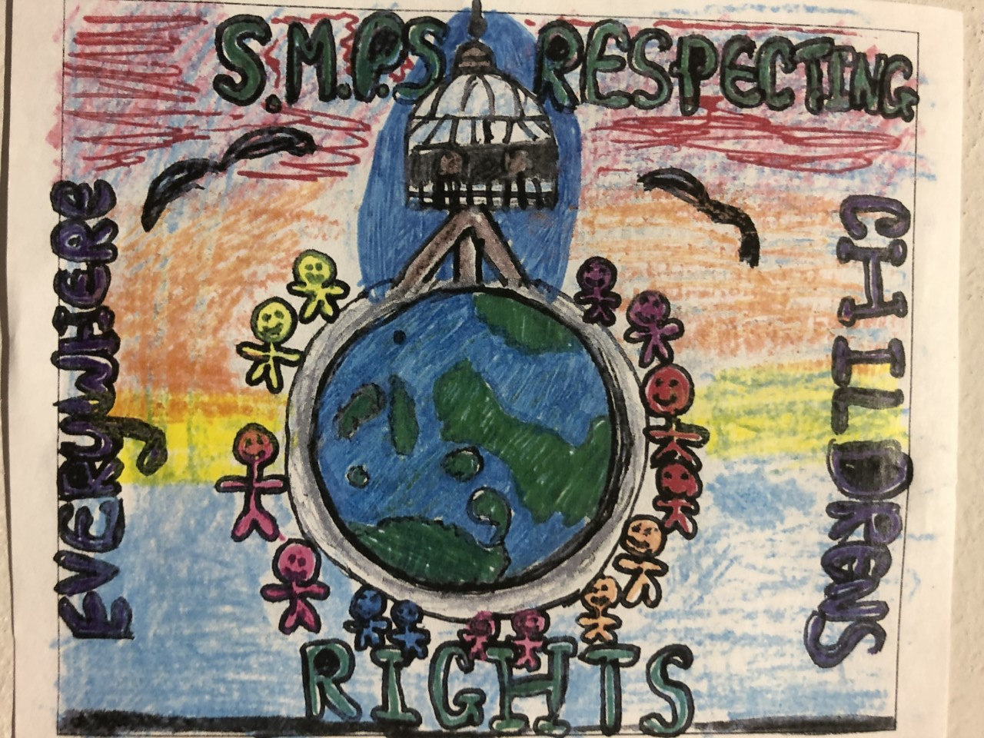
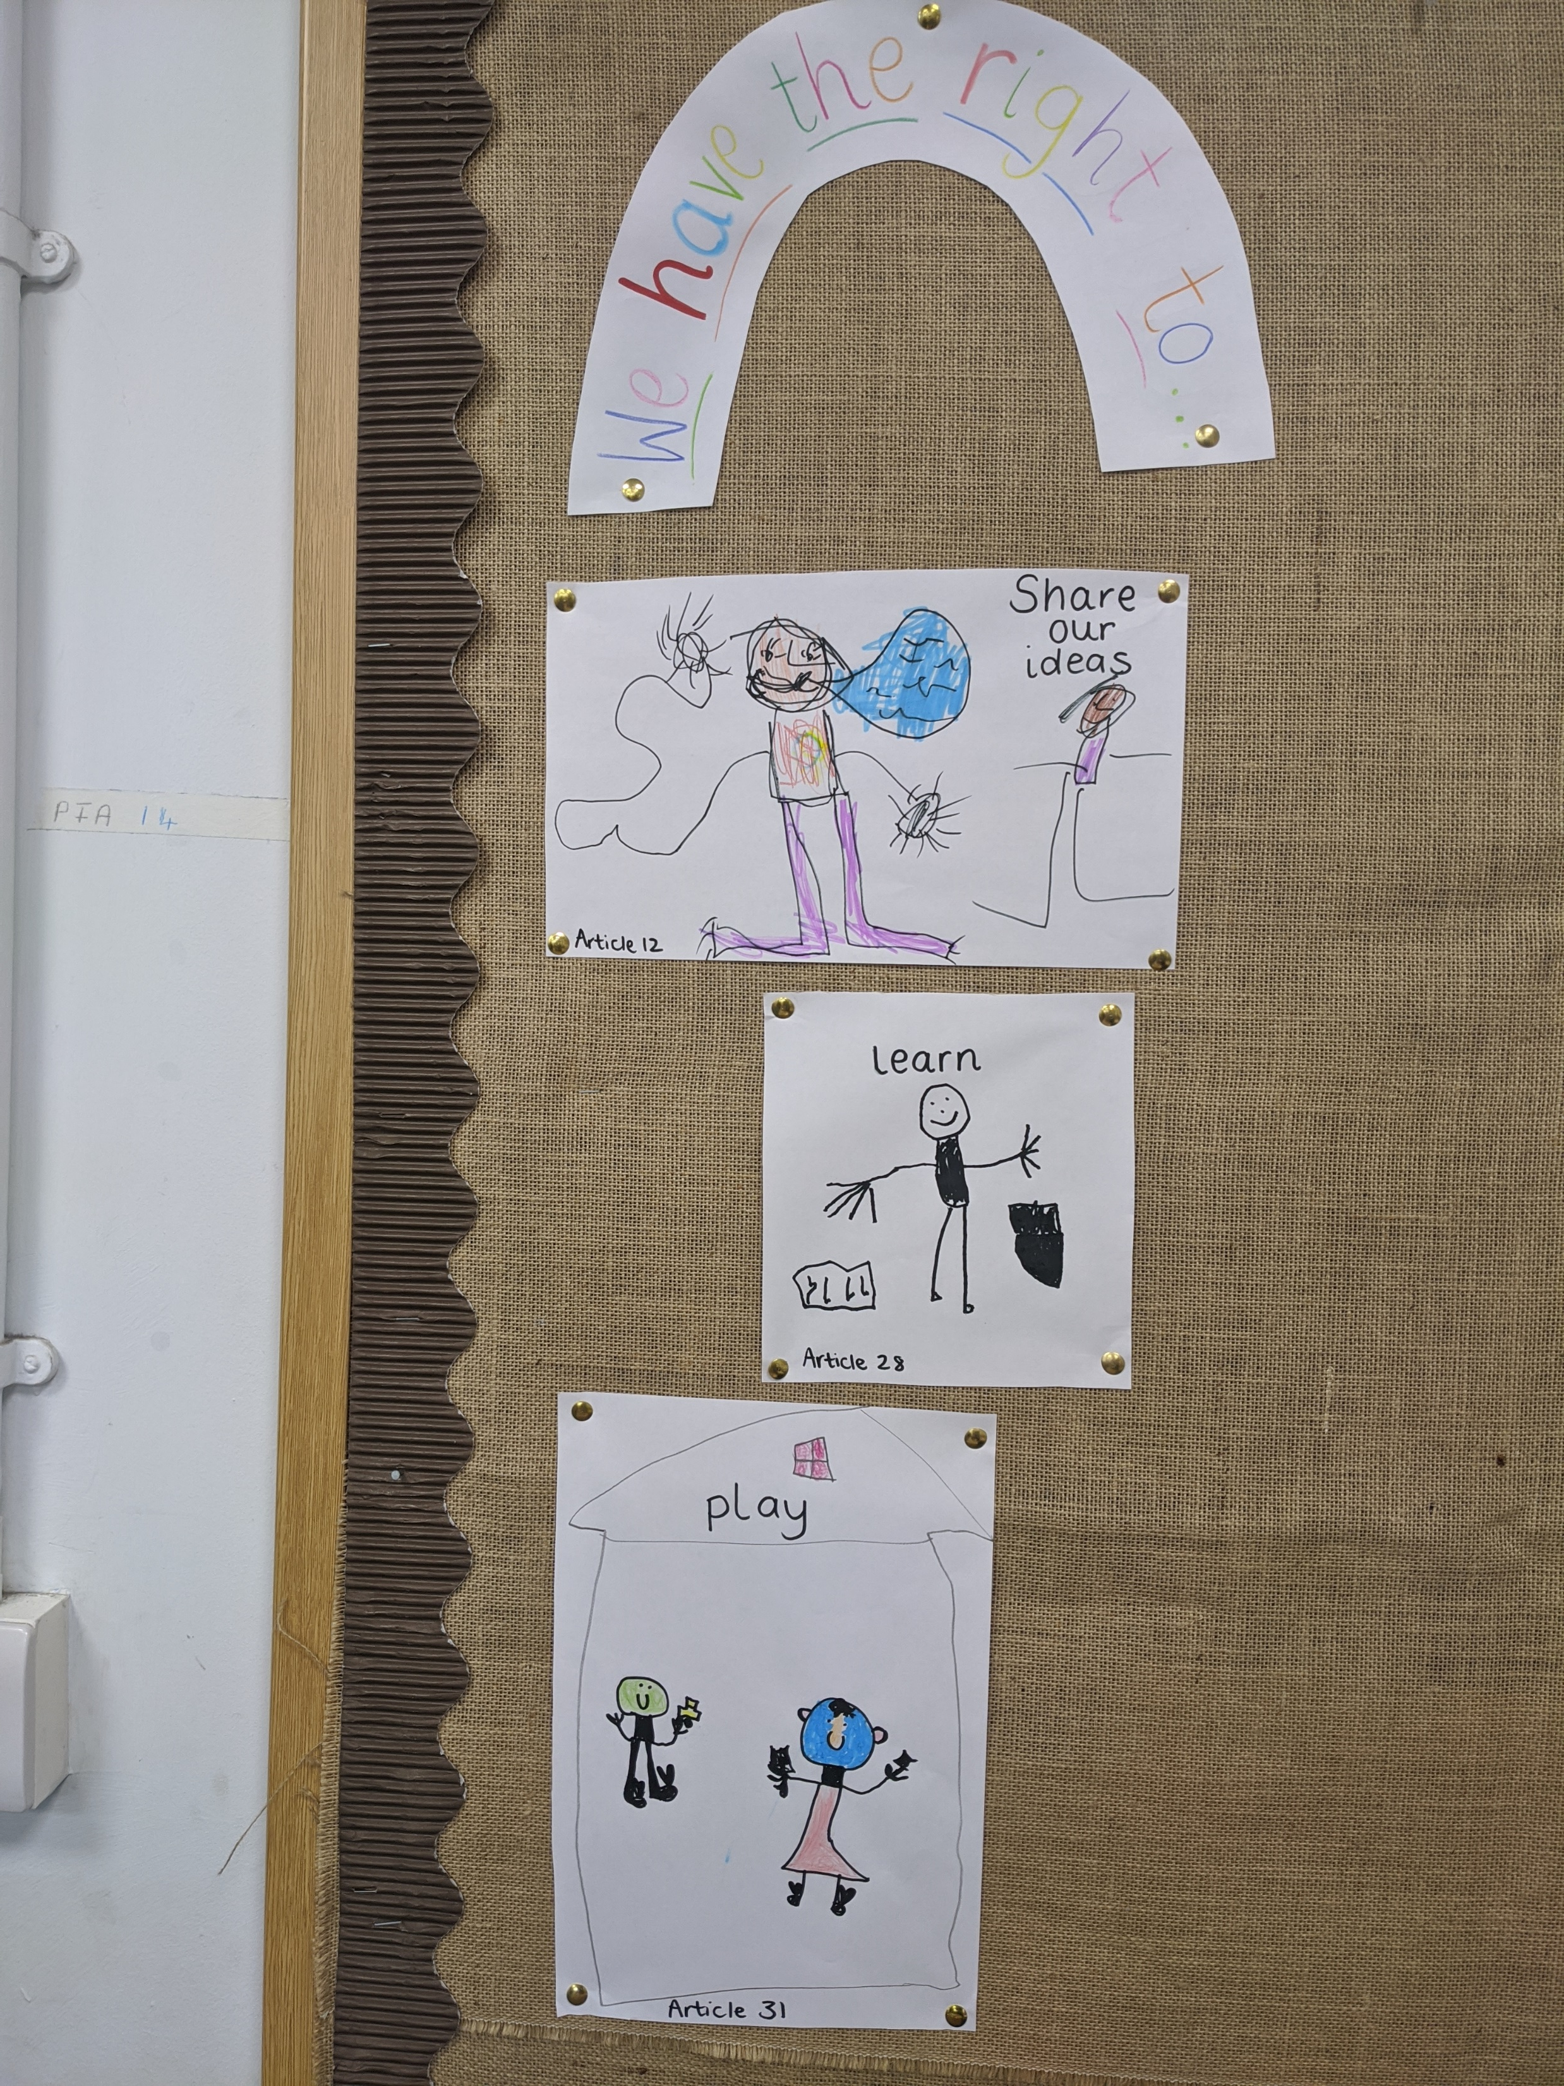
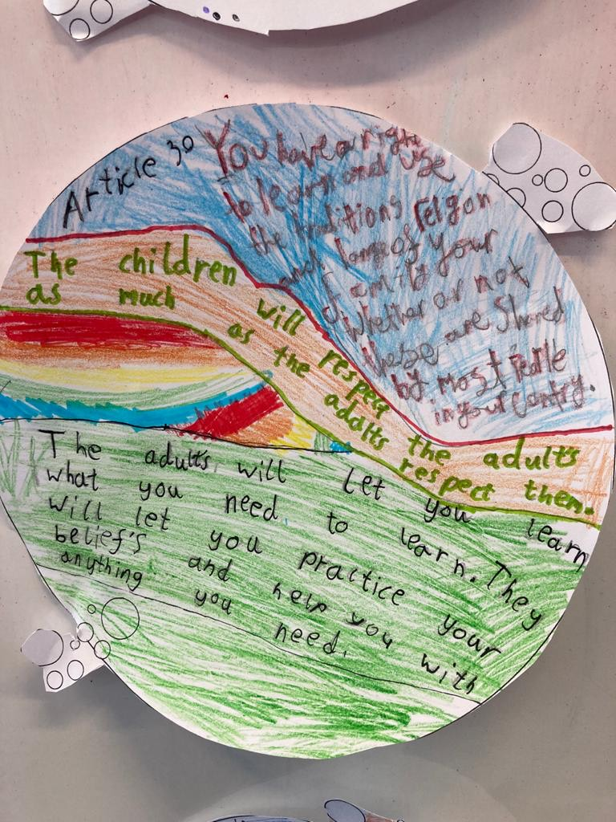
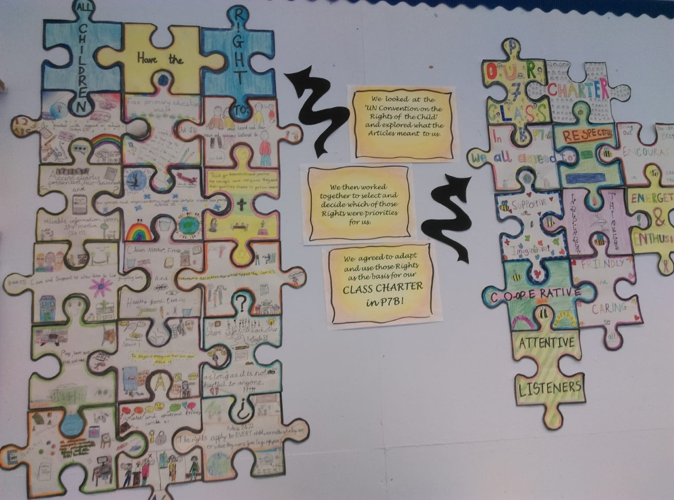
We are a Rights Respecting School
A passion for children’s rights is at the heart of everything we do and informs our policies, procedures and daily practice
Our South Morningside Rights Respecters Group, with a representative from every class, meets regularly and is actively working towards our Silver Level RRS accreditation.
Every class makes a Class Charter using some Articles

Slide 7

Our School Rules
We have 3 School Rules:
Be Respectful
Be Ready
Be Safe

Slide 8
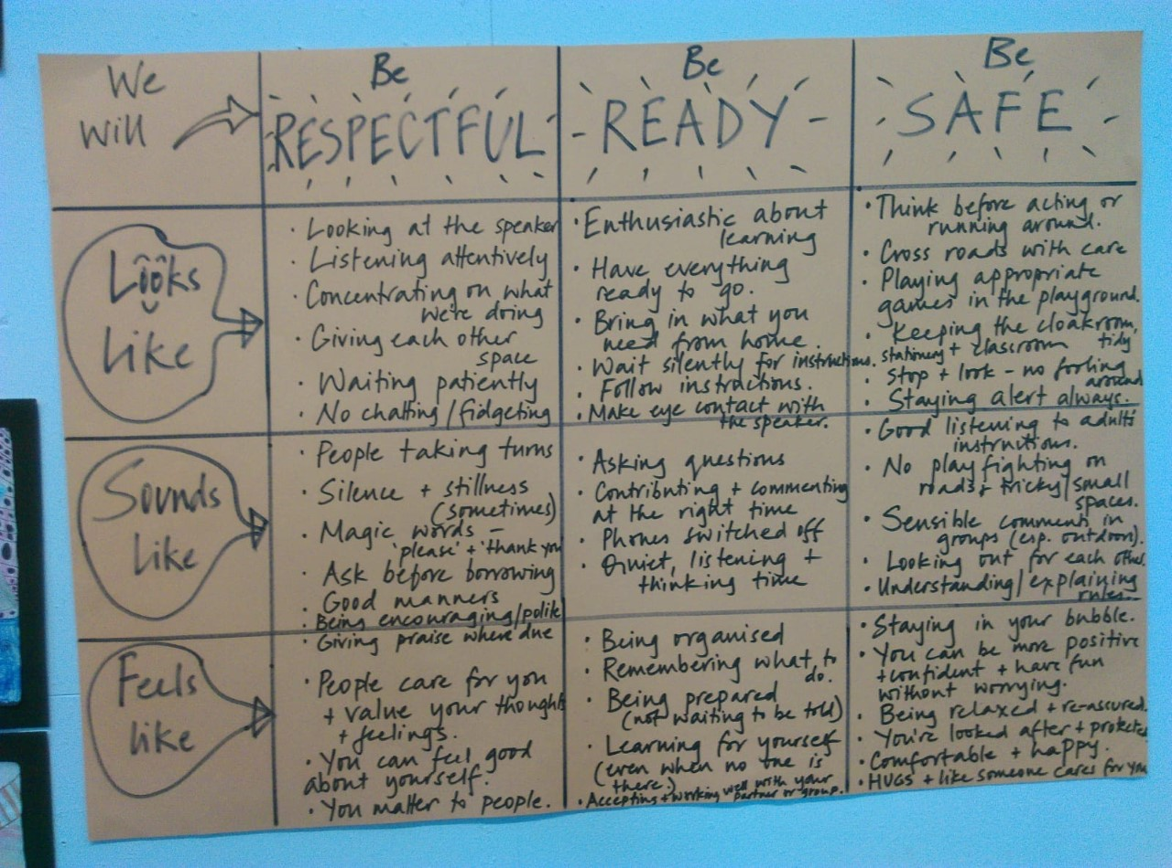
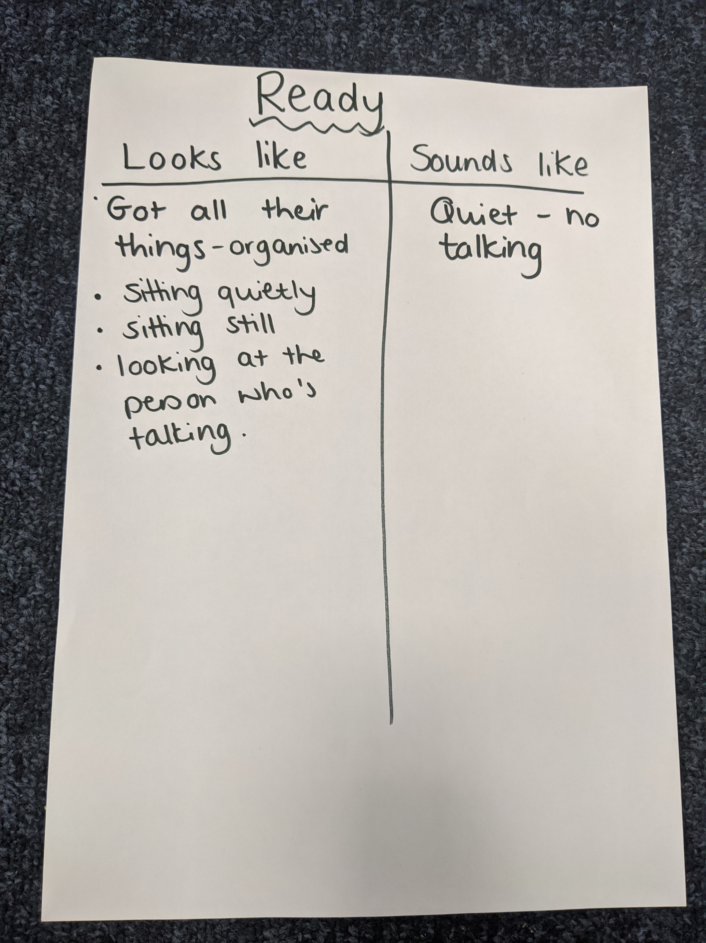
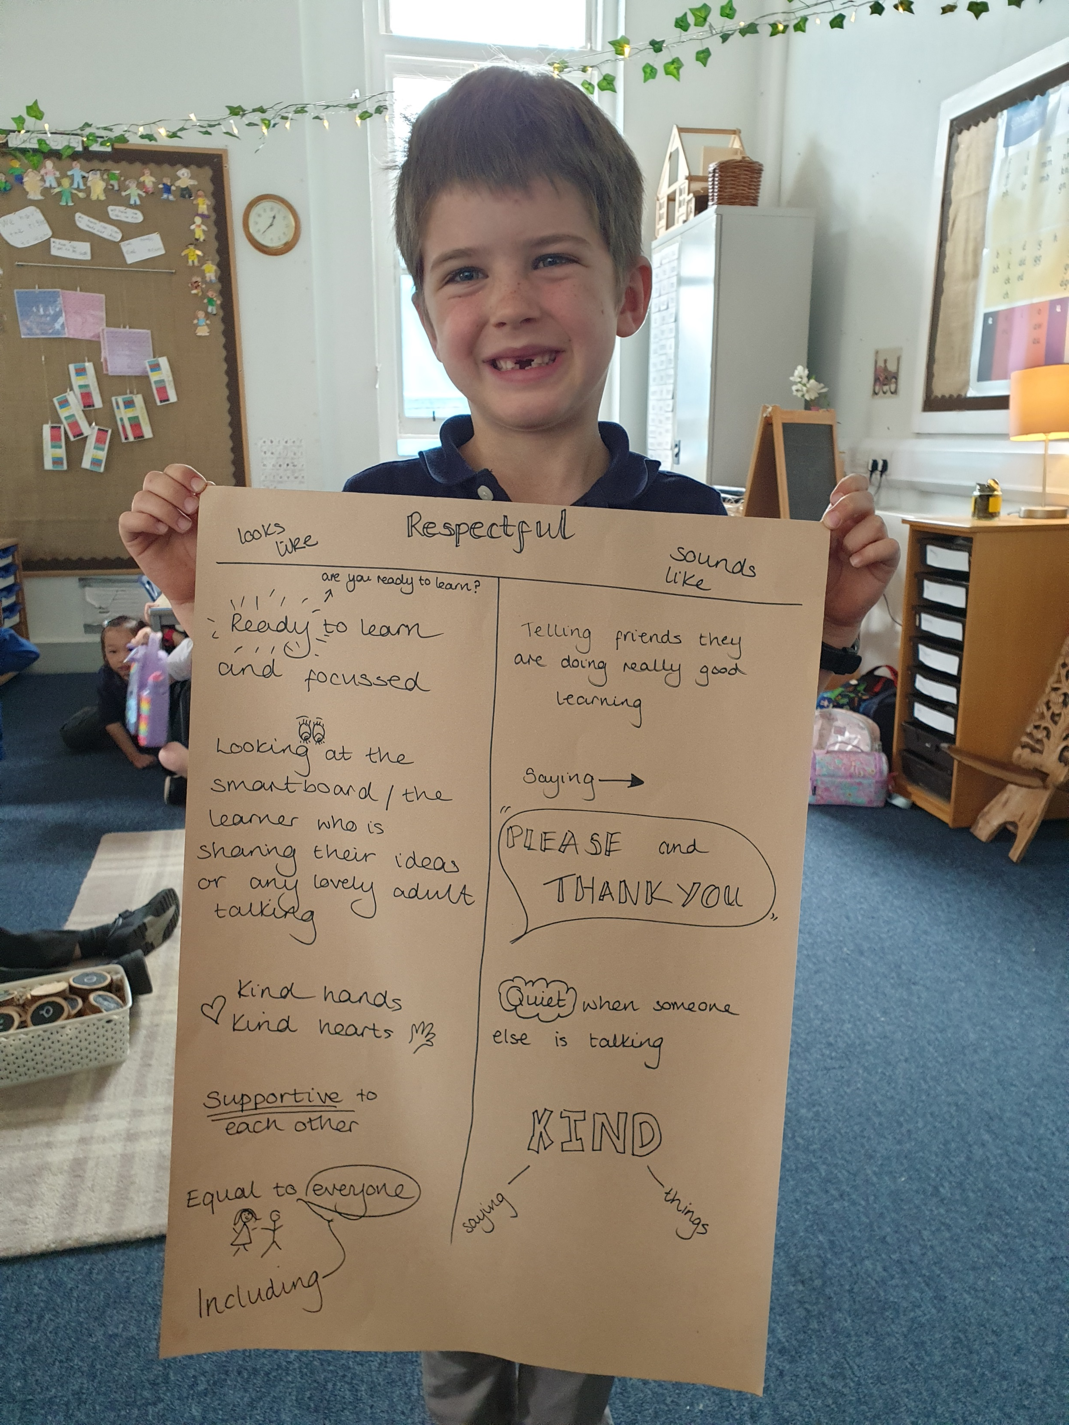
Respectful, Ready, Safe
Each class has been thinking about what it means to be Respectful, Ready and Safe

Slide 9

Going Above and Beyond
We know that the vast majority of children at South Morningside are consistently kind, polite, and enthusiastic and engaged in their learning. So we are always on the look-out for behaviour which is ‘Above and Beyond’.
Children can earn Gold Coins for their House
New for this session, we have Positive Notes
which will be sent home for consistent
Above and Beyond behaviour.

Slide 10
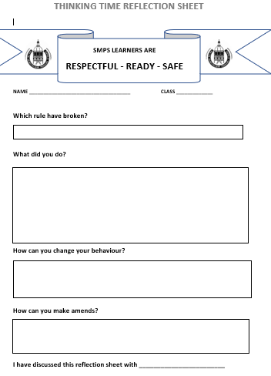
What if someone can’t follow the rules?
If a child can’t follow our School Rules,
then they might be asked to complete a
Reflection Sheet, and then to discuss it
with their teacher or another adult.
We might need to ask a parent to come in and
talk about what else we can do to help a
child follow the school rules.

Slide 11

What is next?
Every family will be given a leaflet with our values, vision and rules
We will make displays and banners with our values, vision and rules
The Policies and Procedures will be put on our website

